Slide 1
2023 Digits Problem
A Variation on a Classic Problem
SPIRE MATHS
Stimulating, Practical, Interesting, Relevant, Enjoyable Maths For All
https://spiremaths.co.uk/2023/

Slide 2
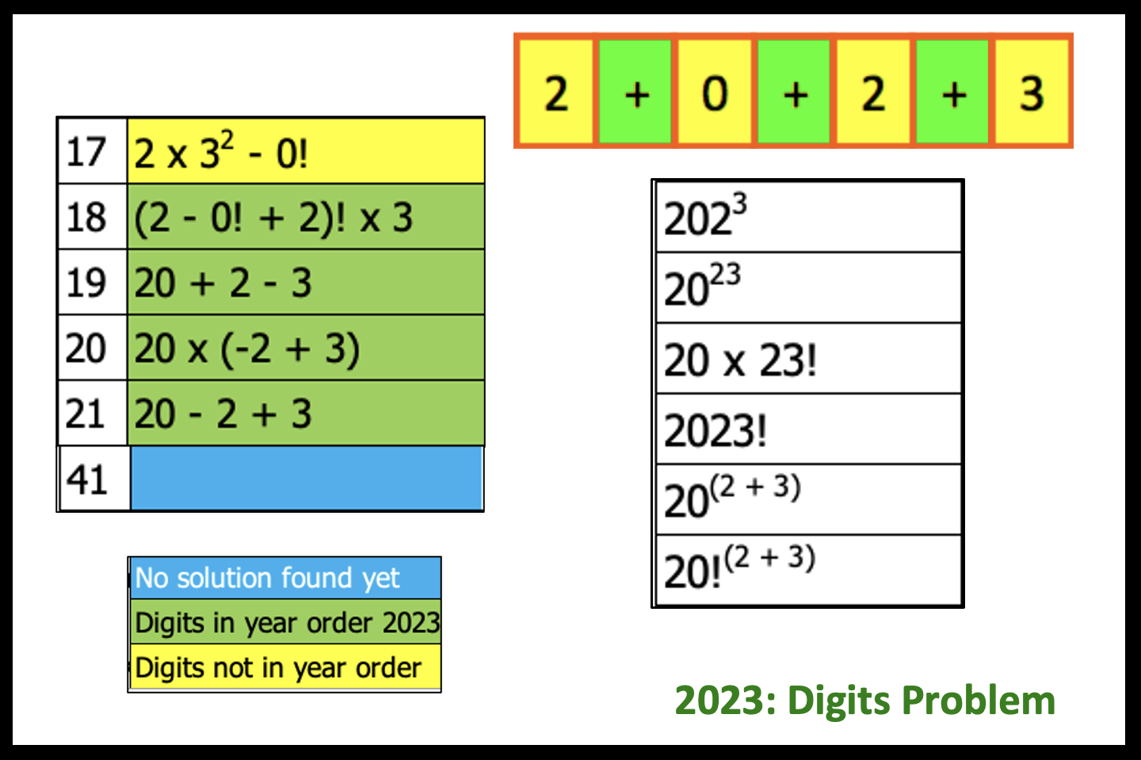
2023 Digits Problem
Answers, worksheet and support documentation provided, see website below.
Excel file lets you find solutions and shows answers.
https://spiremaths.co.uk/2023/
Notes:
Enjoy
Davem195@ntlworld.com

Slide 3
You may want to open the Excel file now
Have the spreadsheet open and ready for your use.
Each mouse click in this PowerPoint file reveals more
All resources for this activity found at:
https://spiremaths.co.uk/2023/
Notes:
Enjoy:
Davem195@ntlworld.com

Slide 4
Use the four digits 2, 0, 2 and 3 exactly once each to make as many numbers as you can. You should check each answer on a calculator. Some numbers, such as 7 shown here can be made by keeping the four numbers of 2023 in that order.
What other numbers can you find? (spend about 5 minutes on this, before going to the next slide)
2023 Digits Problem

Slide 5
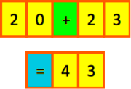
Concatenation is allowed and is needed to make some of the answers. This allows:
So:
But we do not allow:
See next slide for more.
2023 Digits Problem

Slide 6
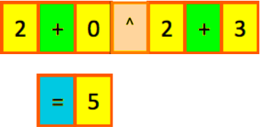
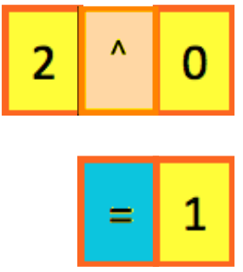
Powers are allowed and used to make some of the answers. This allows:
Note that
So:
In fact: any number to the power of 0 is 1
2023 Digits Problem

Slide 7
The unitary operator FACTORIAL is needed to make some of the answers. Where
And by international agreement (and important here):
What other numbers can you find?
2023 Digits Problem

Slide 8
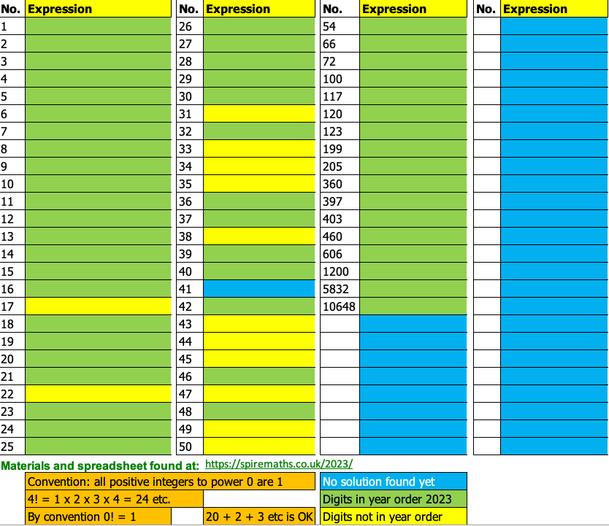
Here are the numbers we have found so far up to 50 and beyond:
No solution yet for 41
Solution not in 2023 order 17, 22, 31,33 to 35, 38, 43 to 45, 47, 49, 50
All others have been found in the order of 2023
2023 Digits Problem

Slide 9
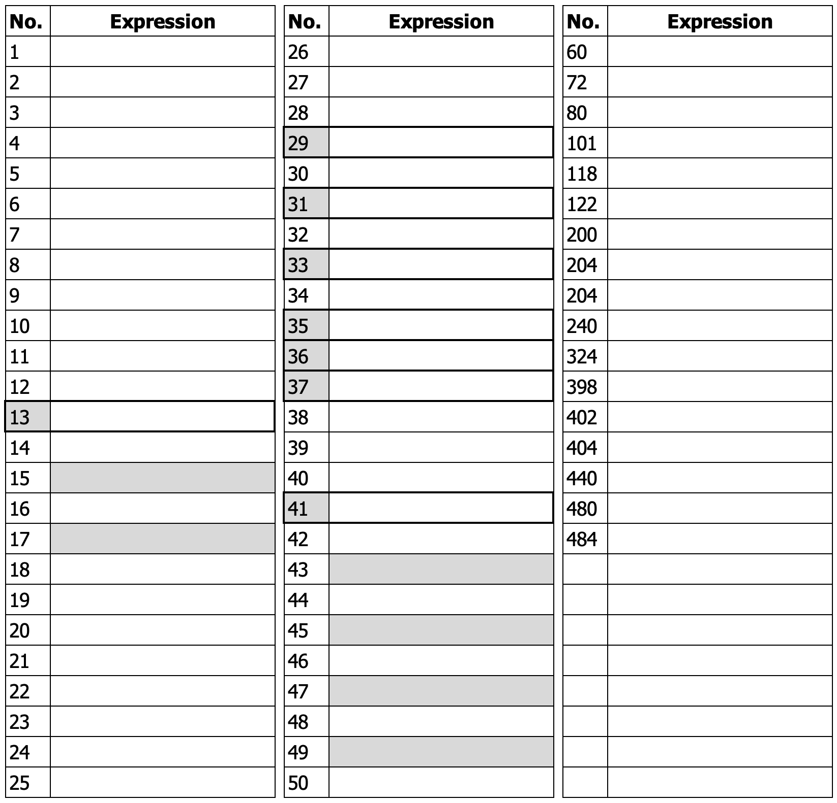
Here are the numbers we have found so far up to 50 and beyond:
No solution yet for 41
Solution not in 2023 order 17, 22, 31,33 to 35, 38, 43 to 45, 47, 49, 50
All others have been found in the order of 2023
2023 Digits Problem

Slide 10
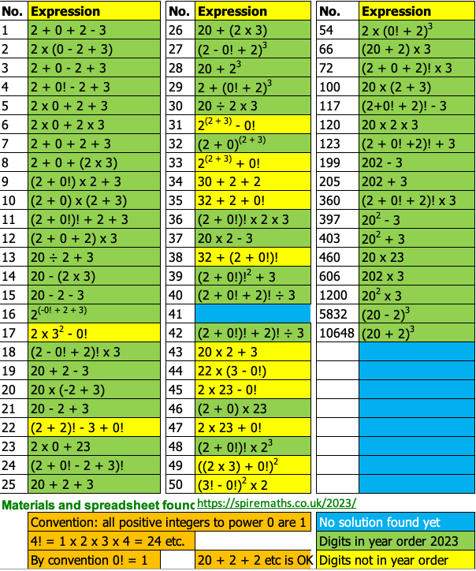
2023 Some solutions

Slide 11
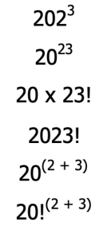
Here are some ideas for larger numbers that can be made. Which do you think will be the largest? Which will 'break' your calculator?
2023 Extras

Slide 12
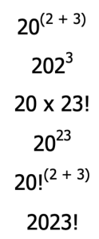
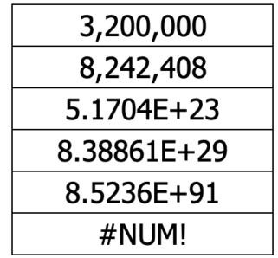
Here are some ideas for larger numbers that can be made. Which do you think will be the largest? Here they are in order
2023 Extras

Slide 13
You might want to do some work now on Standard Form
2023 Extras: Standard Form

Slide 14
Four 4s is the more well-known activity similar to this 2023 Use to support order of operations work.
https://spiremaths.co.uk/four4s/
Similar Activity

