Slide 1
Body Maths: Scatter graphs
SPIRE MATHS
Stimulating, Practical, Interesting, Relevant, Enjoyable Maths For All
https://spiremaths.co.uk/bmscatter/
Notes:
Notes for this scatter graphs lesson available as well as ActivInspire and excel file.

Slide 2
Body Maths: Scatter Graphs
OBJECTIVE(S) | Collect 6 body measurements and use these to draw scatter graphs. Links to mathematics from other cultures, art, ratio and proportion (historically) as well as units of measurement.
DESCRIPTION and OVERVIEW | Africa Counts (Claudia Zaslavsky) building Chagga houses, measurements used. Examples of Chagga houses still available. Laa (span) head-circumference, hat size and height. Quotes from 1973 edition about Chagga process to build house. The Chagga now, information about Tanzania. Door ratios (height of door (laa) ÷ head circumference. Vitruvian Man by Leonardo, what do you notice? Ratios of the body from Vitrvius, Roman architect. Data collection (6 items); calculate 3 value; make your door. Baby adult ratio, how do the skeletons compare when same height Baby adult ratio gif Data collection methods: details. Shoe sizes to cm; feet and inches to cm (for heights). Draw a scatter graph: show how to plot points. People doors: are pupil doors all the same as real doors and more. Laa is UK measurement too – the fathom (6 feet = 183 cm). Vitruvian Man, Leonardo and link to measurements. Data collection and charts – example excel input page. Page to paste data/scatter graphs. Link to podcast from BBC on Vitruvius (42 minutes). Vitruvian Man: baby and adult to same height. Find proportions. Vitruvian Man: 21st century. Make measurements. Further info: 3 pages from The Genesis of Form by Mark Verstockt
EQUIPMENT | There are 4 photocopiable master three providing axes and a grid for scatter graphs, the other a data collection sheet (for e.g. homework).
Download ActivInspire, PowerPoint, Excel file and Teacher Notes from:
Most pages contain other images that will show on next click.
https://spiremaths.co.uk/bmscatter/
Notes:
Overview
Highly recommended you follow the script below. This body maths lesson:
is about Scatter graphs
concerns data collection (and sense of such)
considers historical and cultural information
relates mathematics to the world around us
indirectly relates to ratio and proportion
looks at classical proportions/measurements
considers UK measurements
Basically 6 body measurements, in cm, are to be collected:
laa (span from fingertip to fingertip)
height
head circumference
crown to chin distance
nose length (a vertical distance)
foot length
A spreadsheet is provided
add measurements (pupils do this while making and comparing their doors)
creates 5 scatter graphs (each of the measurements 2 to 6 above plotted against the laa in cm
lets you/pupils make other scatter graphs – need excel charting skills
Collect 6 body measurements and use these to draw scatter graphs. Links to mathematics from other cultures, art, ratio and proportion (historically) as well as units of measurement.
Africa Counts (Claudia Zaslavsky) building Chagga houses, measurements used.
Examples of Chagga houses still available.
Laa (span) head-circumference, hat size and height.
Quotes from 1973 edition about Chagga process to build house.
The Chagga now, information about Tanzania.
Door ratios (height of door (laa) ÷ head circumference.
Vitruvian Man by Leonardo, what do you notice?
Ratios of the body from Vitrvius, Roman architect.
Data collection (6 items); calculate 3 value; make your door.
Baby adult ratio, how do the skeletons compare when same height
Baby adult ratio gif
Data collection methods: details.
Shoe sizes to cm; feet and inches to cm (for heights).
Draw a scatter graph: show how to plot points.
People doors: are pupil doors all the same as real doors and more.
Laa is UK measurement too – the fathom (6 feet = 183 cm).
Vitruvian Man, Leonardo and link to measurements.
Data collection and charts – example excel input page.
Page to paste data/scatter graphs.
Link to podcast from BBC on Vitruvius (42 minutes).
Vitruvian Man: baby and adult to same height. Find proportions.
Vitruvian Man: 21st century. Make measurements.
Further info: 3 pages from The Genesis of Form by Mark Verstockt
There are 4 photocopiable master three providing axes and a grid for scatter graphs, the other a data collection sheet (for e.g. homework).
Enjoy
Davem195@ntlworld.com

Slide 3
Africa counts describes how traditional Chagga people from the foothills of Mt Kilimanjaro used to construct their traditional beehive-shaped houses.
What do you think they did to decide its size and proportions? Its base radius Door height Door width?
Chagga Homes 1
Notes:
The Lesson Script
We start with the work of Claudia Zaslavsky and her brilliant book Africa Counts. In this she writes about and shows pictures of the homes of the Chagga people who live in the foothills of Mount Kilimanjaro, which is in Tanzania.
Look at the dwellings shown here
Quoting from the book:
“When a Chagga built his traditional beehive-shaped house on the fertile slope of Mount Kilimanjaro, he called upon the tallest man he knew. His neighbour would lie flat upon the site of the prospective home, with his arms outstretched. The span from the fingertips of one hand to those of the other is called a laa. To mark off the circumference, the builder tied a hoe to a rope of length equal to the desired radius, two to three laa. The rope was attached to a peg, and as he walked around this peg, he drew a circle with his hoe.”
So this leads to a question – look at the room you are in, would you fit a Chagga dwelling in it?
Finally Claudia Zaslavsky tells us how the dimensions of the ‘door’, or perhaps more correctly the entrance to the Chagga home were decided. What do you think?

Slide 4
See original of above
See original of below
See original of above
Chagga Homes 2
Notes:
The Lesson Script
We start with the work of Claudia Zaslavsky and her brilliant book Africa Counts. In this she writes about and shows pictures of the homes of the Chagga people who live in the foothills of Mount Kilimanjaro, which is in Tanzania.
Look at the dwellings shown here
Quoting from the book:
“When a Chagga built his traditional beehive-shaped house on the fertile slope of Mount Kilimanjaro, he called upon the tallest man he knew. His neighbour would lie flat upon the site of the prospective home, with his arms outstretched. The span from the fingertips of one hand to those of the other is called a laa. To mark off the circumference, the builder tied a hoe to a rope of length equal to the desired radius, two to three laa. The rope was attached to a peg, and as he walked around this peg, he drew a circle with his hoe.”
So this leads to a question – look at the room you are in, would you fit a Chagga dwelling in it?
Finally Claudia Zaslavsky tells us how the dimensions of the ‘door’, or perhaps more correctly the entrance to the Chagga home were decided. What do you think?

Slide 5
Base radius - decided by the laa of the tallest man arms outstretched, the distance from one fingertip to the other Door height = one laa Door width = head circumference of the man
Questions 1. If the base radius was 2-3 laa, would you be able to fit one of these houses into the room you are in now? 2. Would you be able to fit through your own door without ducking or would you hit your head? 3. When this book was written (1973) many men would know their hat size (in inches). What is yours (in cm)? 4. Are you square, is your height the same as your laa?
Chagga Homes 3
Notes:
The Lesson Script continued
Finally Claudia Zaslavsky tells us how the dimensions of the ‘door’, or perhaps more correctly the entrance to the Chagga home were decided. What do you think?
You might have worked out how they decided the height of the door, but you are very unlikely to have worked out the body measurement used to decide the width of the door.
“The door height was equal to the span of the man's arms; its width was the circumference of his head, measured by a string.”
So if you collect your own laa and your own height, would you get through your own door without bending and without hitting your head?
Do you know roughly what your head circumference is?
Well these are three pieces of data that you will need to collect: your laa (that is your arm span), your height and your head circumference.
Interestingly this measurement (of the laa) has a parallel in Britain – do you know what that is? (See later)

Slide 6
When a Chagga built his traditional beehive-shaped house on the fertile slope of Mount Kilimanjaro, he called upon the tallest man he knew. His neighbour would lie flat upon the site of the prospective home, with his arms outstretched. The span from the fingertips of one hand to those of the other is called a laa. To mark off the circumference, the builder tied a hoe to a rope of length equal to the desired radius, two to three laa. The rope was attached to a peg, and as he walked around this peg, he drew a circle with his hoe. The door height was equal to the span of the man's arms; its width was the circumference of his head, measured by a string.
Today (i.e. 1973) the Chagga people, prosperous form the proceeds of their coffee cultivation, build roomy oblong houses. But the traditional beehive shape is preserved in the immense entrance hall to the Kibo Art Gallery supported in the centre by a massive tree trunk. In a sedentary agricultural society, the round house often takes the form of a cylindrical structure topped by a cone-shaped roof.
The above is original edition of 1973 and a page is shown here:
Chagga Homes 4
Notes:
The Lesson Script
Finally Claudia Zaslavsky tells us how the dimensions of the ‘door’, or perhaps more correctly the entrance to the Chagga home were decided. What do you think?
You might have worked out how they decided the height of the door, but you are very unlikely to have worked out the body measurement used to decide the width of the door.
“The door height was equal to the span of the man's arms; its width was the circumference of his head, measured by a string.”
So if you collect your own laa and your own height, would you get through your own door without bending and without hitting your head?
Do you know roughly what your head circumference is?
Well these are three pieces of data that you will need to collect: your laa (that is your arm span), your height and your head circumference.
Interestingly this measurement (of the laa) has a parallel in Britain – do you know what that is? (See later)

Slide 7
http://www.climbmountkilimanjaro.com/about-the-mountain/the-chagga/chagga-origins/
On the southern slopes of Mt. Kilimanjaro, Africa's highest mountain, live the Chagga people, also called Chaga, Waschagga, Jagga, or Dschagga. Administratively, the area lies in the Kilimanjaro region in northern Tanzania, south of the border with Kenya. The region is further divided into three districts - Hai to the west, Rombo to the east, and Vunjo in the centre.
The Chagga now
http://www.climbmountkilimanjaro.com/about-the-mountain/the-chagga/social-structure-and-village-life/
https://www.climbmountkilimanjaro.com/about-the-mountain/the-chagga/chagga-origins/
Notes:
More information

Slide 8
Collect your measurements: Laa Height Head circumference
Questions:
Can you get through your own door?
What is your door ratio (door height divided by door width)?
Is your door the same shape as someone else's door?
What about doors in your house, your school, other buildings?
People Doors
Notes:
What do you think?

Slide 9
Leonardo (1452 - 1519) called this drawing Vitruvian man. Why do you think this is? What do you notice about the diagram?
Vitruvian Man
Notes:
Leonardo da Vinci made a very famous drawing that used a number of body measurements including the fathom – it is called Vitruvian man and consists of the front view of a man apparently with four legs - two together and two spread out (one on each side). The man also has four arms – two straight at right angles to his trunk, one each side, and the other two also to his side and stretched straight but higher. The man is inside a square and a circle so that his arms and legs that are at right angles, as well as the top of his head touch the sides of the square and the other four limbs touch the circumference of the circle.
The centres of the circle and the square are the same – at the navel of the man.

Slide 10
Vitruvius was Roman and lived in the first century BC. He was an architect, engineer and author and wrote one of the first books on architecture called De architectura, a book for Roman architects. This gave some information about the proportions of the body. Here are two statements:
a third part of the face is from the line between the eyebrows to the bottom of the nostrils
the foot is a sixth of the height of the body
To consider this collect more data:
Chin to crown (face length)
Nose length (eyebrows to nostrils height)
Foot length
All in cm
Marcus Vitruvius Pollo
Notes:
He based this work on the writings of Vitruvius who was a Roman who lived in the first century BC and wrote one of the first books on architecture. In this book he made some statements about the proportions of the body. Here are a few of them:
the head from the top of the head to the chin is one eighth of the height of the body
the nose from the bottom of the nostrils to the line between the eyebrows is one third
the foot is one sixth of the height
We will take some more measurements to see what if what he said is still true

Slide 11
Collect your measurements (all in cm): Laa Height (see next page for ft and inches conversion to cm) Head circumference Chin to crown (face length) Nose length (eyebrows to nostrils height) Foot length (see next page for shoe size conversion to cm) Calculate your: Door ratio (laa ÷ head circumference) Chin ÷ Nose (how close to 3 is it?) Height ÷ Foot (how close to 6 is it?) Make with graph paper and cut out your: Door (using your measurements - laa and head circumference) Do you think people have changed since the time of the Romans? if so how, and why?
Data Collection
Notes:
He based this work on the writings of Vitruvius who was a Roman who lived in the first century BC and wrote one of the first books on architecture. In this book he made some statements about the proportions of the body. Here are a few of them:
the head from the top of the head to the chin is one eighth of the height of the body
the nose from the bottom of the nostrils to the line between the eyebrows is one third
the foot is one sixth of the height
We will take some more measurements to see what if what he said is still true – the three extra measurements we will collect are:
your head height – from the top of your head to your chin
your nose size (its height) from the bottom of your nostrils to the line between the eyebrows
your foot size
Having collected the information, put them into the spreadsheet in my computer in the correct place – the column headings are for your data.

Slide 12
Data Collection Methods
Notes:
How to collect your data: Shoe sizes follow. Original taken from Activity Maths 6 and 7 Dave Miller (1991).

Slide 13
Data Collection: Shoe size conversion
Notes:
Shoe sizes to cm

Slide 14
Baby and adult are scaled up/down so they are the same height.
What ratios can you find in this diagram?
Vitruvian Man: baby and adult to same height
Notes:
Pupils can do this while others input data into computer. Original taken from Activity Maths 6 and 7 Dave Miller (1991).

Slide 15
Vitruvian Man: baby and adult to same height
Notes:
This gif shows answers to ratios shown on slide. Original taken from Activity Maths 6 and 7 Dave Miller (1991).

Slide 16
Click Ctrl P to use pen to add points to this chart
Drawing a Scatter Graph
Click Ctrl P to plot points on screen
Notes:
Show how to plot a scatter graph if needed.

Slide 17
Questions:
Can you get through your own door?
What is your door ratio (door height divided by door width)?
Is your door the same shape as someone else's door?
What about doors in your house, your school, other buildings?
How do you compare your doors with other people and know if they are the same shape?
People Doors
Notes:
Collect some answers and see what pupils think. Typical examples are shown for ‘average’ adults.

Slide 18
The Fathom = 6 feet
≈ 180 cm
What is the UK unit equivalent to the laa?
Notes:
Interestingly this measurement (of the laa) has a parallel in Britain – do you know what that is?
It is the fathom, a nautical measurement used to measure the depth of water. It probably came about from the way in which sailors measured the depth of the water, using a rope with a lead weight at the end of it and pulling the rope taut across their chest from one fingertip to fingertip then letting the lead weight drop down into the water. Each pull of the rope across the chest would mean another fathom of rope would drop straight down into the water.

Slide 19
Leonardo (1452 - 1519) called this drawing Vitruvian man. Why do you think this is? What do you notice about the diagram?
Vitruvian Man
Notes:
Leonardo da Vinci made a very famous drawing that used a number of body measurements including the fathom – it is called Vitruvian man and consists of the front view of a man apparently with four legs - two together and two spread out (one on each side). The man also has four arms – two straight at right angles to his trunk, one each side, and the other two also to his side and stretched straight but higher. The man is inside a square and a circle so that his arms and legs that are at right angles, as well as the top of his head touch the sides of the square and the other four limbs touch the circumference of the circle.

Slide 20
An excel spreadsheet is available that will let you add 40 rows of data and it will automatically create these scattergraphs. If you know about excel you will be able to copy and convert the scattergraphs.
Data Collection and Charts
Notes:
These are taken from the spreadsheet.

Slide 21
Paste your data/scatter graphs here for pupils to use, then delete this
Data Collection and Scatter Graphs
Notes:
For you to e.g. add the pupil data from the spreadsheet so pupils can create their own scatter graphs using the worksheet templates.

Slide 22
Download MP3
Podcast on Vitruvius starts at 1 minute - you may need to sign in to the BBC: it is free.
ps://www.bbc.co.uk/programmes/b01d2kzx
Podcast on Vitruvius
Notes:
This may interest you.

Slide 23
What ratios can you find in this diagram?
Vitruvian Man: 21st century
Notes:
Original in Activity Maths 6 and 7 Dave Miller (1991)

Slide 24
Further information
Notes:
This may be of further interest.

Slide 25
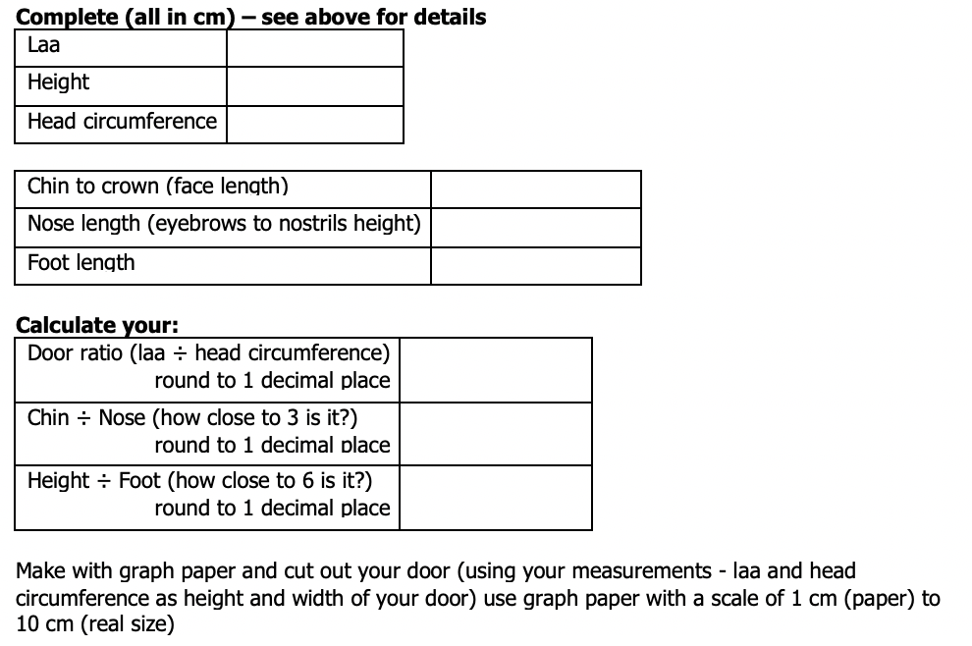
Copies in the Teacher Notes
Resource Sheet 1
Notes:
Photocopiable master. Originals taken from Activity Maths 6 and 7 Dave Miller (1991).

Slide 26
Copies in the Teacher Notes
Resource Sheet 2
Notes:
Photocopiable master.

Slide 27
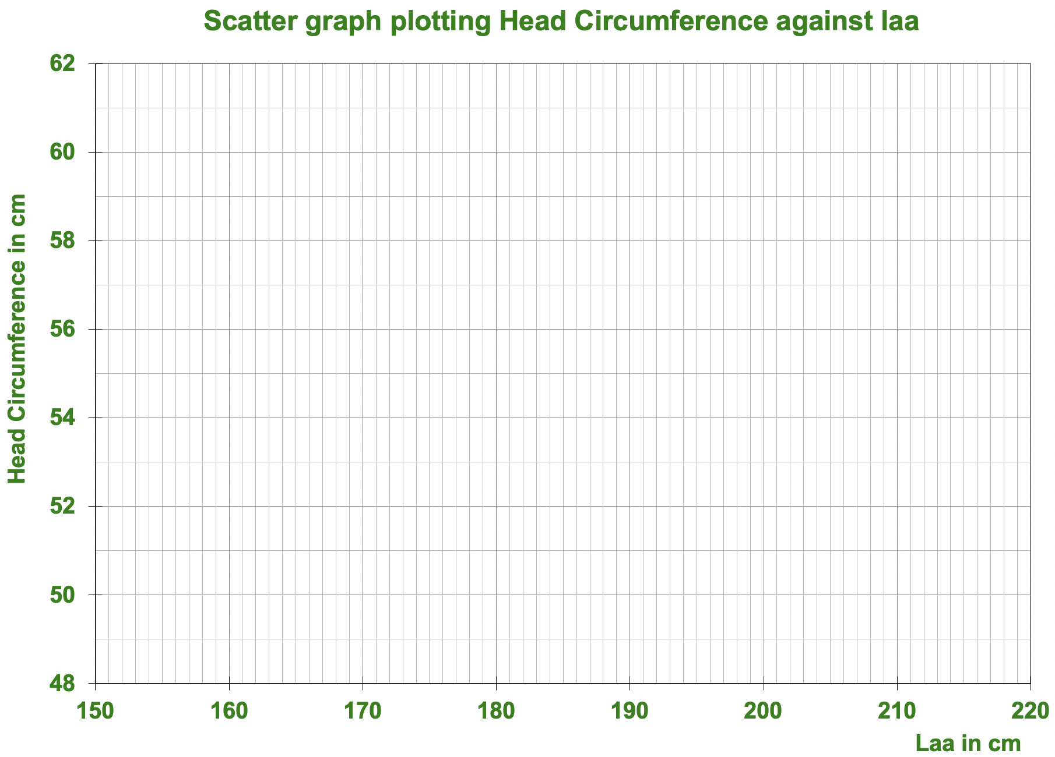
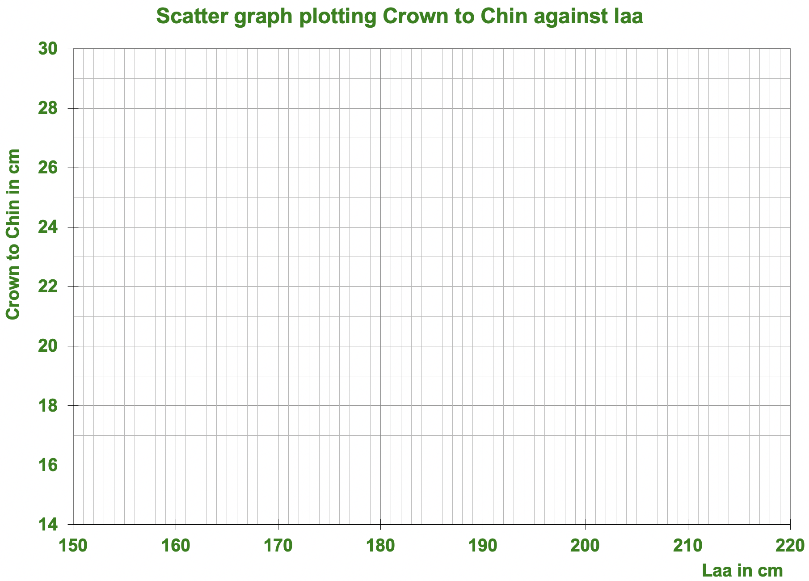
Copies in the Teacher Notes
Resource Sheet 3
Notes:
Photocopiable master.

Slide 28
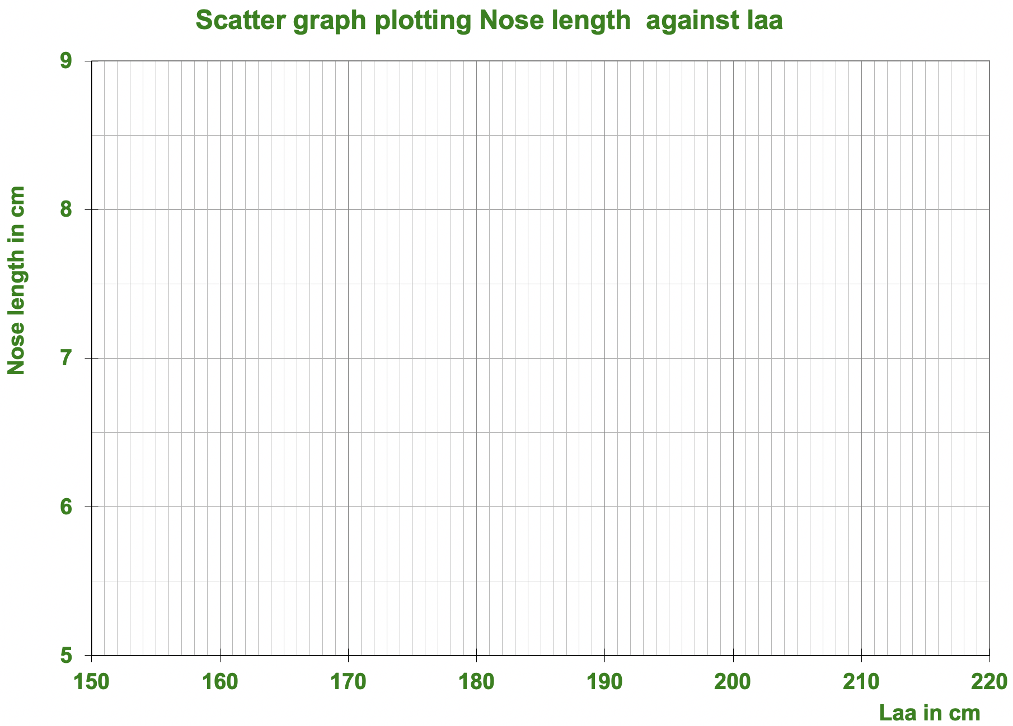
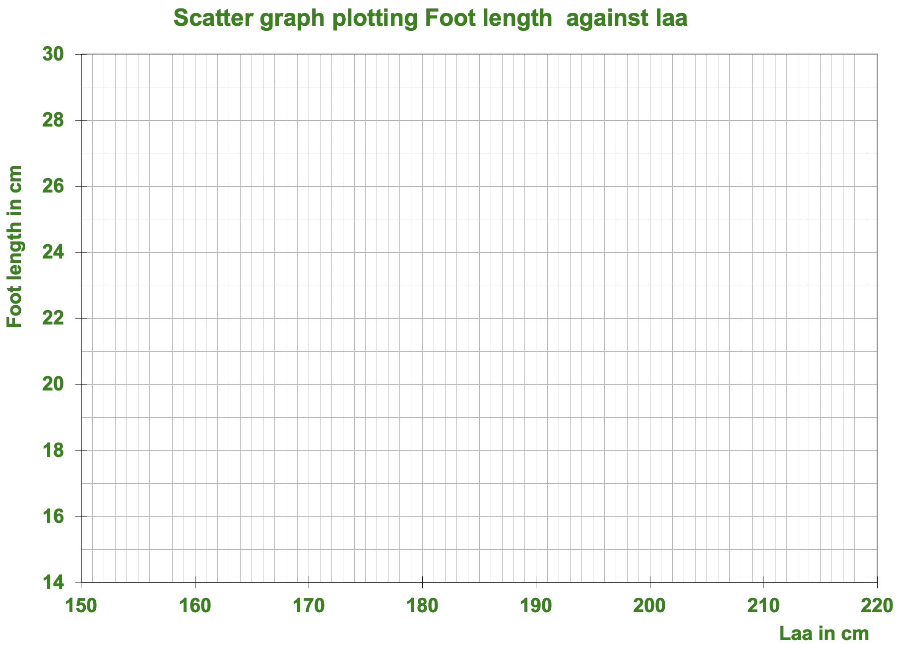
Copies in the Teacher Notes
Resource Sheet 4
Notes:
Photocopiable master.

