Slide 1
Circumference of a Circle
SPIRE MATHS
Stimulating, Practical, Interesting, Relevant, Enjoyable Maths For All
https://spiremaths.co.uk/circlecircumference/

Slide 2
Answers, PowerPoint, gifs, Teacher notes and GeoGebra demonstrations: support documentation is provided, see website below. Excel file for charts and answers.
https://spiremaths.co.uk/circlecircumference/
Circumference of a Circle

Slide 3
Three circles, different numbers of spokes (4, 10, 36)
Three circles, different numbers of lines (2, 5, 18)
All diameters and all lines of symmetry
What do you see?
What do you notice?
Joining the ends of the spokes will make polygons with 4, 10 and 36 sides
Polygons in a circle

Slide 4
You should do this in groups
Collect your set of 9 circles: all should have diameter 10 cm, one of each with 4, 6, 8, 10, 12, 18, 20, 24 and 36 spokes.
Count number of spokes of the circle
Measure diameter of circle
Draw straight line between ends of one pair of adjacent spokes
Measure length of this line
Calculate total perimeter around polygon if you joined all the ends of adjacent spokes
Polygons in a circle

Slide 5
You should do this in groups
Count number of spokes of the circle
Measure diameter of circle
Draw straight line between ends of one pair of adjacent spokes
Measure length of this line
Calculate total perimeter around polygon if you joined all the ends of adjacent spokes
Polygons in a circle
Fill in the table (this can be done in the Excel version)

Slide 6
Plot the points on the grid here where the x-values are found in the Number of spokes column and the y-values in the Total polygon perimeter column.
What happens as the x-value increases and the polygon gets to look more like a circle?
Calculate π times the circle diameter. What do you notice?
Polygons in a circle

Slide 7
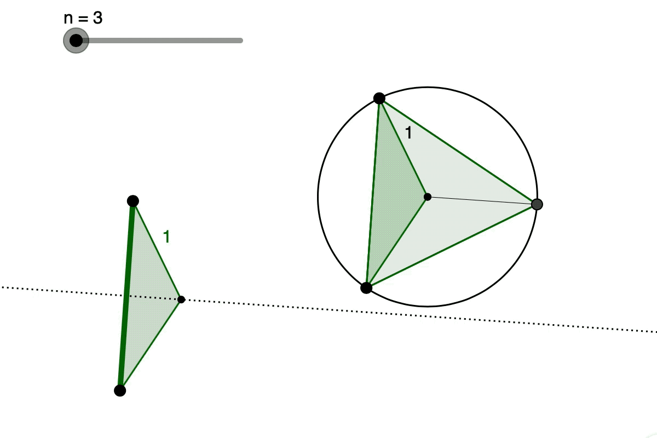
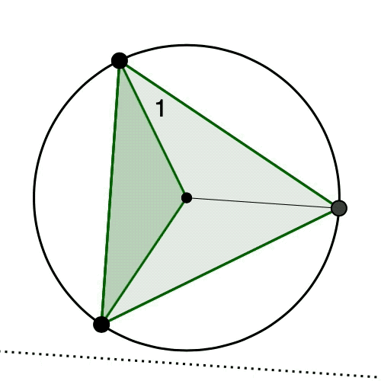
What do you see? What do you notice?
Two Animations

Slide 8
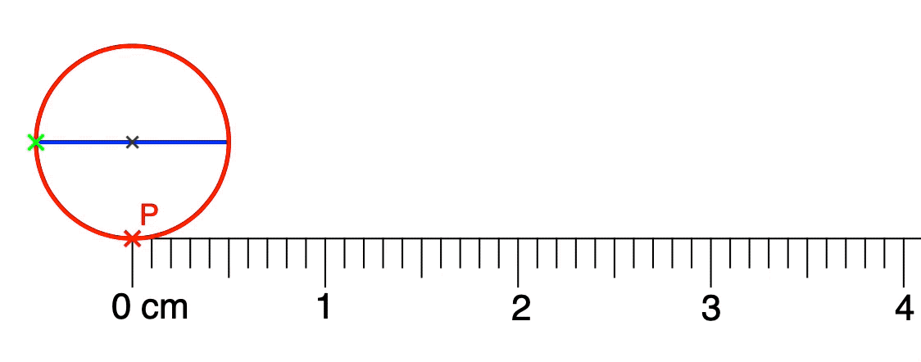
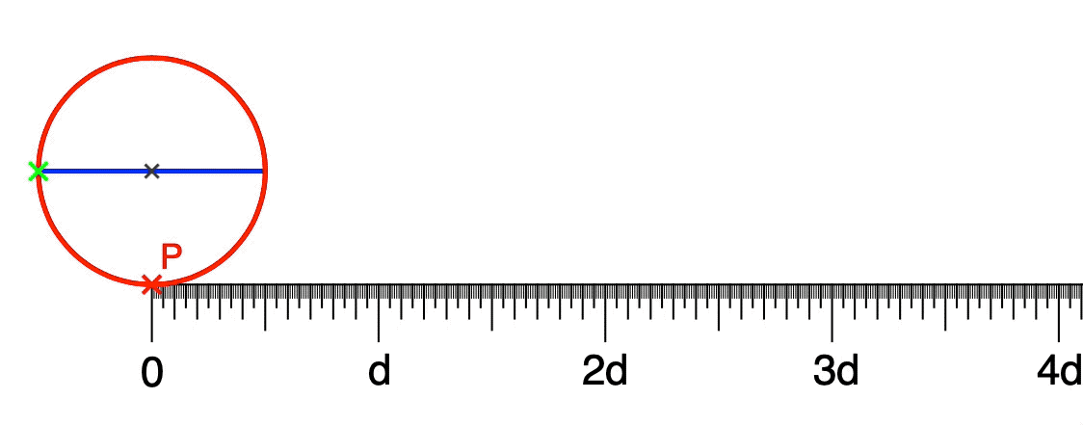
What do you see? What do you notice?
Two More Animations

Slide 9
These are the calculated answers based on 10 cm diameter circles.
Count number of spokes of the circle
Measure diameter of circle
Draw straight line between ends of one pair of adjacent spokes
Measure length of this line
Calculate total perimeter around polygon if you joined all the ends of adjacent spokes
Polygons in a circle: Answers 1

Slide 10
Here is theoretical graph - see next slide for possible pupil graph
Plot the points on the grid here where the x-values are found in the Side length column and the y-values in the Total polygon perimeter column.
What happens as the x-value increases and the polygon gets to look more like a circle?
Calculate π times the circle diameter. What do you notice?
Polygons in a circle: Answers 2

Slide 11
A possible pupil graph
This graph can arise from real measurements to nearest mm
Plot the points on the grid here where the x-values are found in the Side length column and the y-values in the Total polygon perimeter column.
What happens as the x-value increases and the polygon gets to look more like a circle?
Calculate π times the circle diameter. What do you notice?
Polygons in a circle: Possible Answers 3

Slide 12
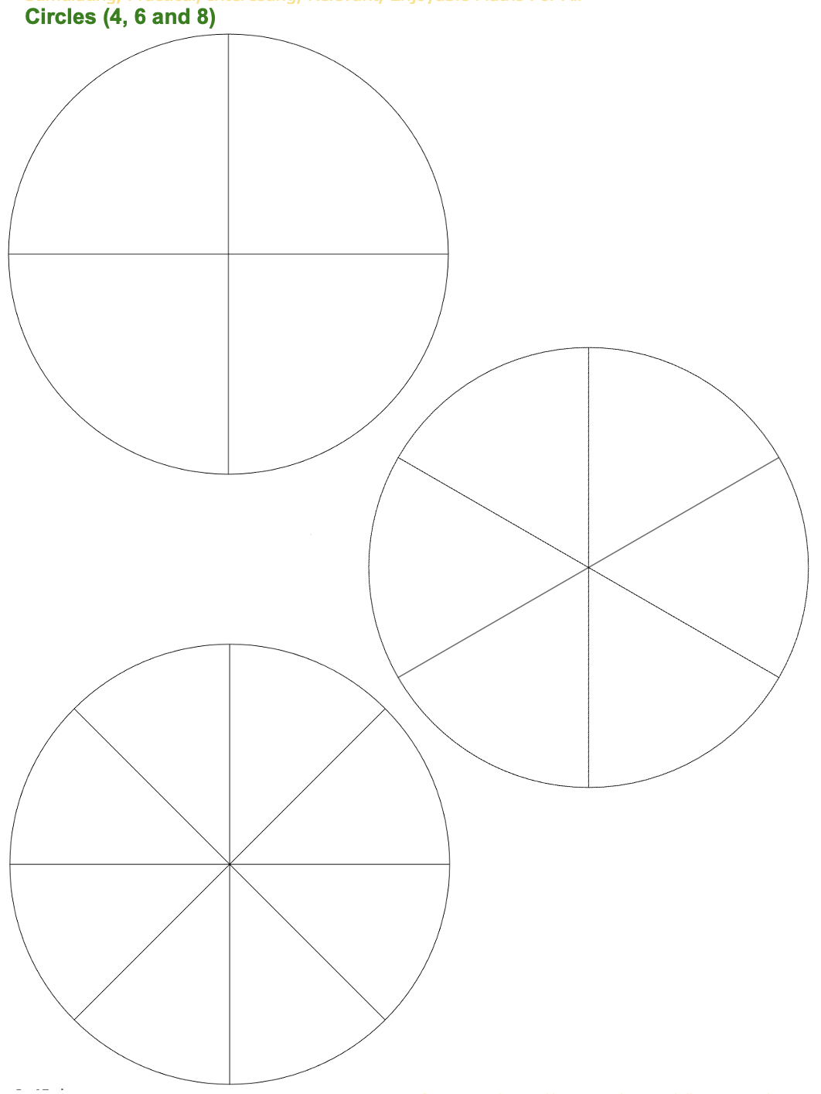
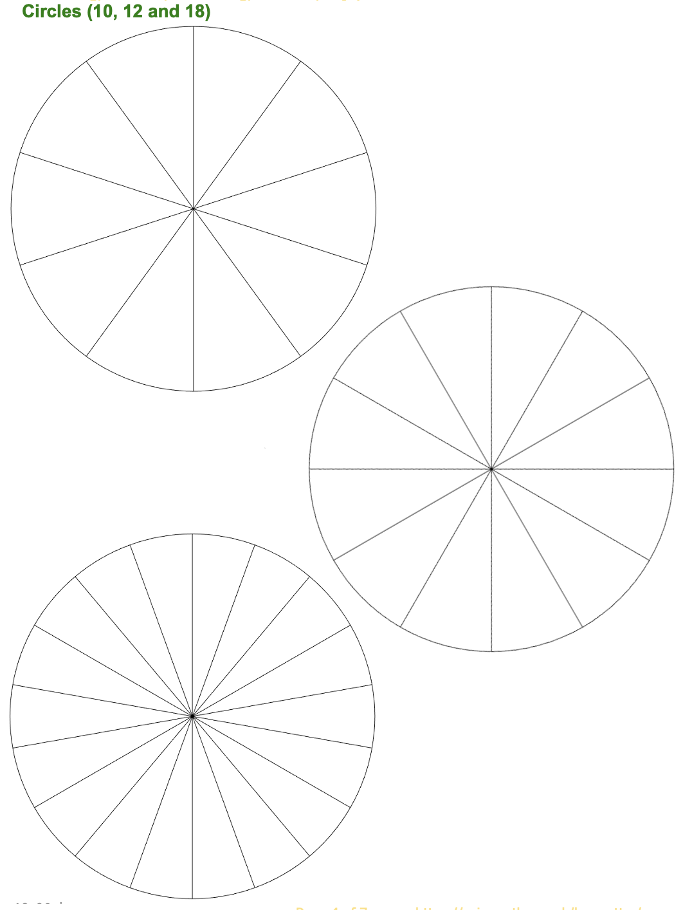
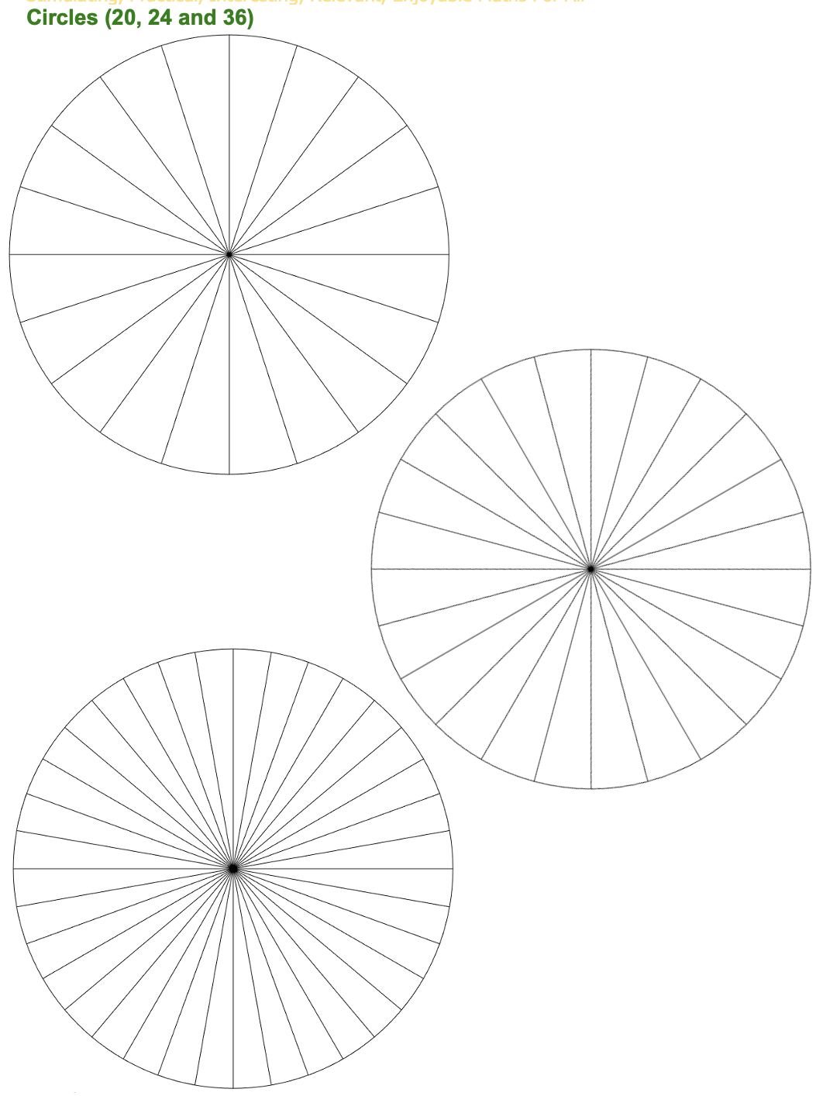
Resources

