Slide 1
Factors and Prime Factors
SPIRE MATHS
Stimulating, Practical, Interesting, Relevant, Enjoyable Maths For All
https://spiremaths.co.uk/factorsandprimefactors/

Slide 2
Factors and Prime Factors
TYPE: | Main (Slides 3 – 14) and 19 – 20 photocopiable masters
OBJECTIVE(S): | Recognise/use multiples, factors (divisors), highest common factor, lowest common multiple and primes; prime factor decomposition.
DESCRIPTION: | activities. 1 you find the highest common factor of 2 numbers. 2 and 3 are about prime factors. 4 is about prime factorisation.
OVERVIEW: | The highest common factor of two numbers and prime factors.
EQUIPMENT: | Calculators may be helpful for many pupils, especially for activities 3 and 4. Two photocopiable masters are supplied one containing 8 copies of a possible factor tree diagram (with three levels) and the other containing 8 copies of a Venn diagram.
TYPE: | Review (Slides 15 – 18)
OBJECTIVE(S): | Recognise/use multiples, factors (divisors), highest common factor, lowest common multiple and primes; prime factor decomposition.
DESCRIPTION: | 3 activities. 1 finds HCF of two numbers. 2 writes a number as the product of prime factors. 3 uses prime factors to find the HCF.
OVERVIEW: | The highest common factor of two numbers and prime factors.
EQUIPMENT: | Calculators may be useful.
This was originally created in flash. Ignore text about Next, New etc. just click the mouse to advance the file. Question and await responses rather than move on too quickly.
Notes:
These activities were originally designed in flash and still work in June 2020 on my version of ActivInspire:
They are therefore included with the ActivInspire version of the file.
This PowerPoint file is based on the original flash file.
If you are interested in more of these files with Flash files in ActivInspire files please contact me:
Davem195@ntlworld.com

Slide 3
Notes:
Screen 1: The highest common factor
You are given a red and a blue number and a red and a blue circle that intersect inside a rectangle (in effect a Venn diagram). You can then either click Next where you are asked to find all the factors of the pair of numbers, or you can click Collect and you will be 'given' them. (For more on this see the year 7 main activity "Factors and fractions".) In both cases you finish with all the factors of both numbers beneath the Venn diagram. You are then asked to drag the factors of the red number inside the red circle and the factors of the blue number inside the blue circle - so common factors have to be placed inside the intersection. You are asked "What is the highest common factor of the two numbers?" but none of this is checked - this is left to you.
Key points: it may not be obvious that factors of both should be placed inside the intersection, so leave this for your pupils to work out; likewise it may not be apparent that the highest common factor is in the intersection; you may also want your pupils to describe the numbers in each section of the rectangle and for some it may be appropriate to work with set notation.

Slide 4
Notes:
Screen 1: The highest common factor
You are given a red and a blue number and a red and a blue circle that intersect inside a rectangle (in effect a Venn diagram). You can then either click Next where you are asked to find all the factors of the pair of numbers, or you can click Collect and you will be 'given' them. (For more on this see the year 7 main activity "Factors and fractions".) In both cases you finish with all the factors of both numbers beneath the Venn diagram. You are then asked to drag the factors of the red number inside the red circle and the factors of the blue number inside the blue circle - so common factors have to be placed inside the intersection. You are asked "What is the highest common factor of the two numbers?" but none of this is checked - this is left to you.
Key points: it may not be obvious that factors of both should be placed inside the intersection, so leave this for your pupils to work out; likewise it may not be apparent that the highest common factor is in the intersection; you may also want your pupils to describe the numbers in each section of the rectangle and for some it may be appropriate to work with set notation.

Slide 6
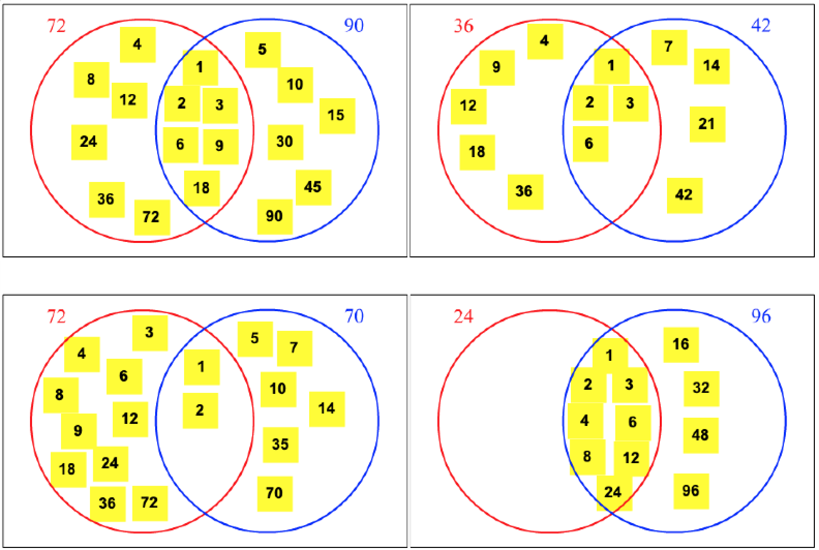
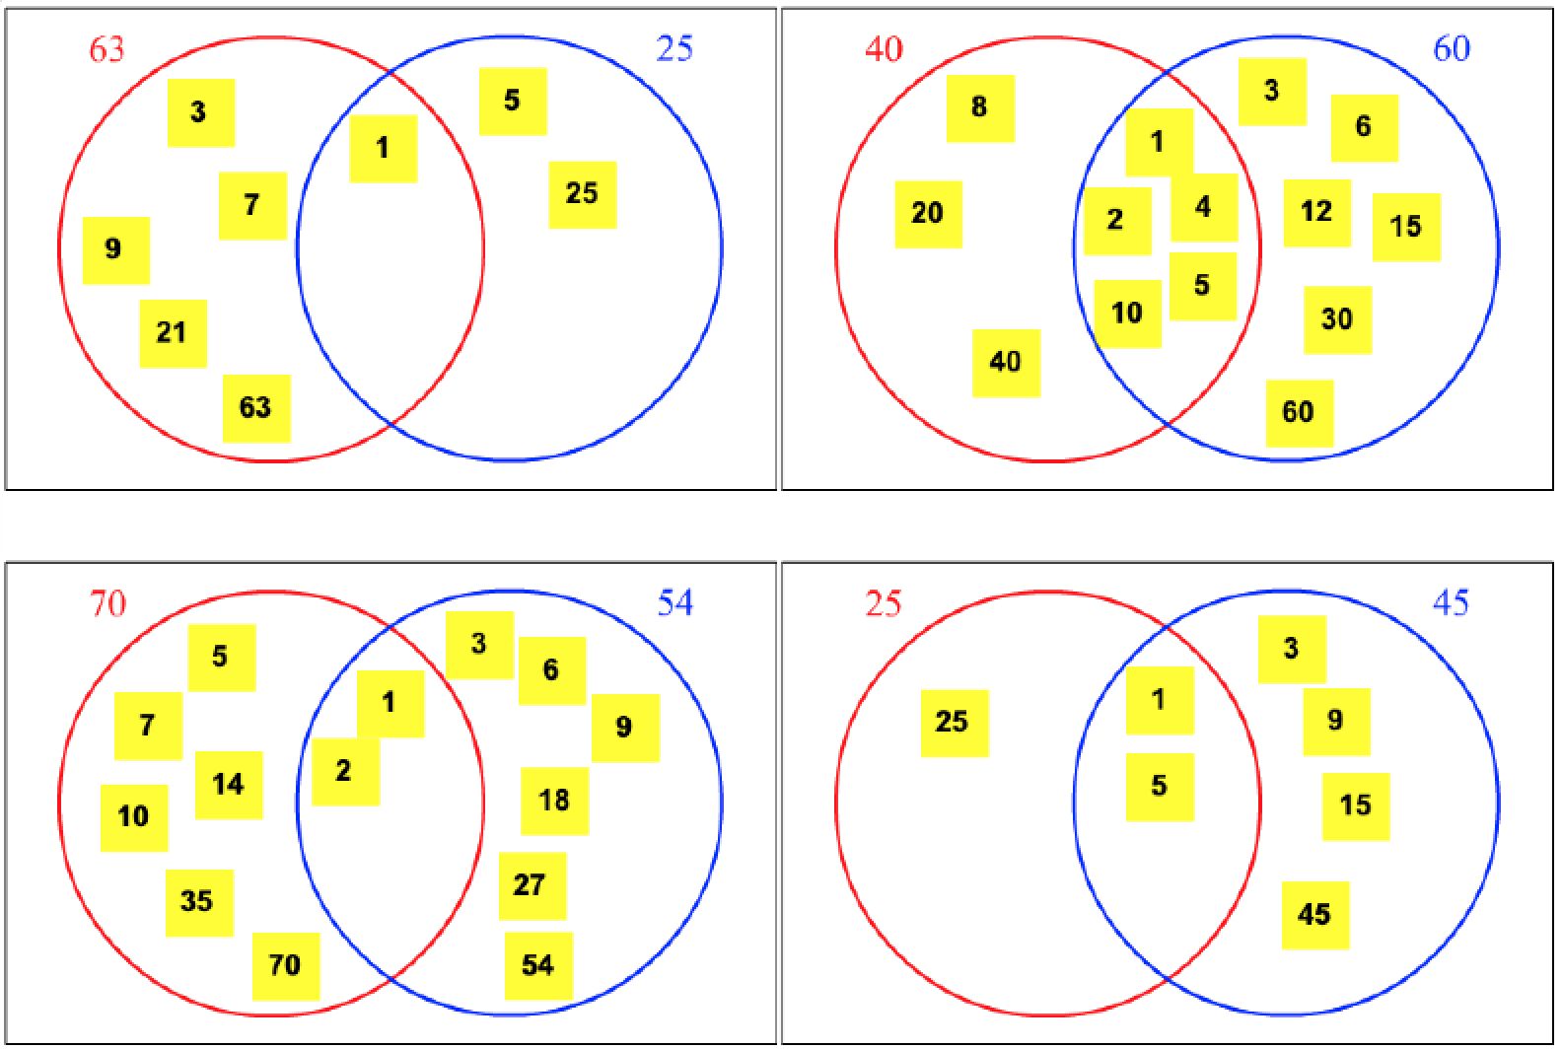
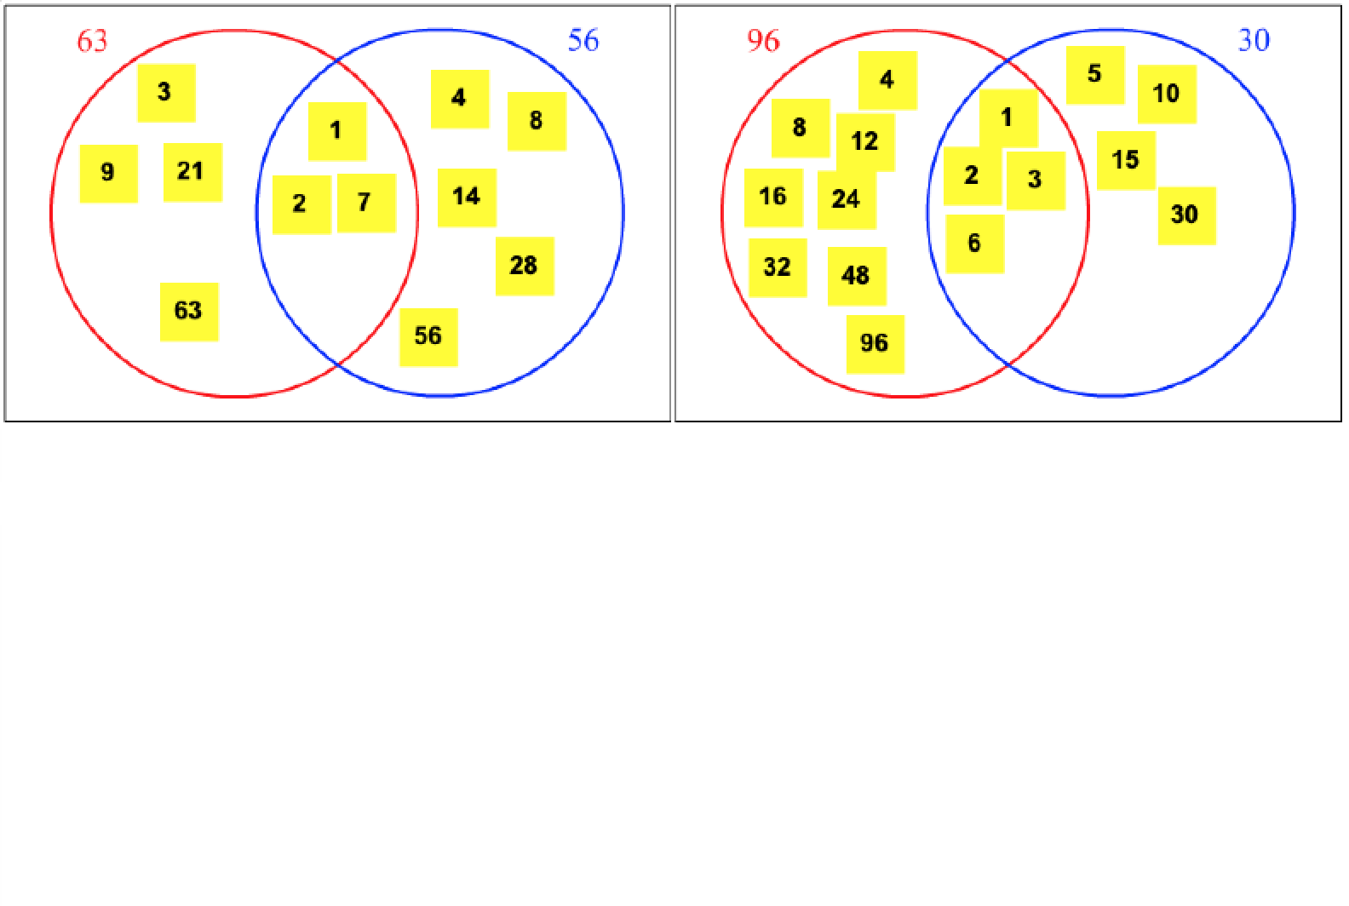

Slide 7
Notes:
Screen 2: Prime factors and factor trees
A number is shown inside a yellow circle at the top of the screen with two 'branches' coming from it each leading to a blue cell. You are asked to use the keypad to enter a pair of factors that multiply to make the number in the yellow circle (and 1 is not allowed). When you have done this correctly, each blue cell that has more than 2 factors has two branches leading to a blue cell, so that more factors can be found. When you get to all the prime factors you are told that the factor tree can be used to write the number as the product of its prime factors and this is shown. For diagrammatic reasons, the only numbers used have prime factors of 2, 3, 5 and 7 and will only extend, at most, down to a third row.
Key points: finding factor pairs and whether it makes a difference how you do it; why this works; combining the same factor to give powers of factors; for many pupils you may wish to extend this to larger numbers and to numbers with more prime factors.

Slide 8
Notes:
Screen 2: Prime factors and factor trees
A number is shown inside a yellow circle at the top of the screen with two 'branches' coming from it each leading to a blue cell. You are asked to use the keypad to enter a pair of factors that multiply to make the number in the yellow circle (and 1 is not allowed). When you have done this correctly, each blue cell that has more than 2 factors has two branches leading to a blue cell, so that more factors can be found. When you get to all the prime factors you are told that the factor tree can be used to write the number as the product of its prime factors and this is shown. For diagrammatic reasons, the only numbers used have prime factors of 2, 3, 5 and 7 and will only extend, at most, down to a third row.
Key points: finding factor pairs and whether it makes a difference how you do it; why this works; combining the same factor to give powers of factors; for many pupils you may wish to extend this to larger numbers and to numbers with more prime factors.

Slide 9
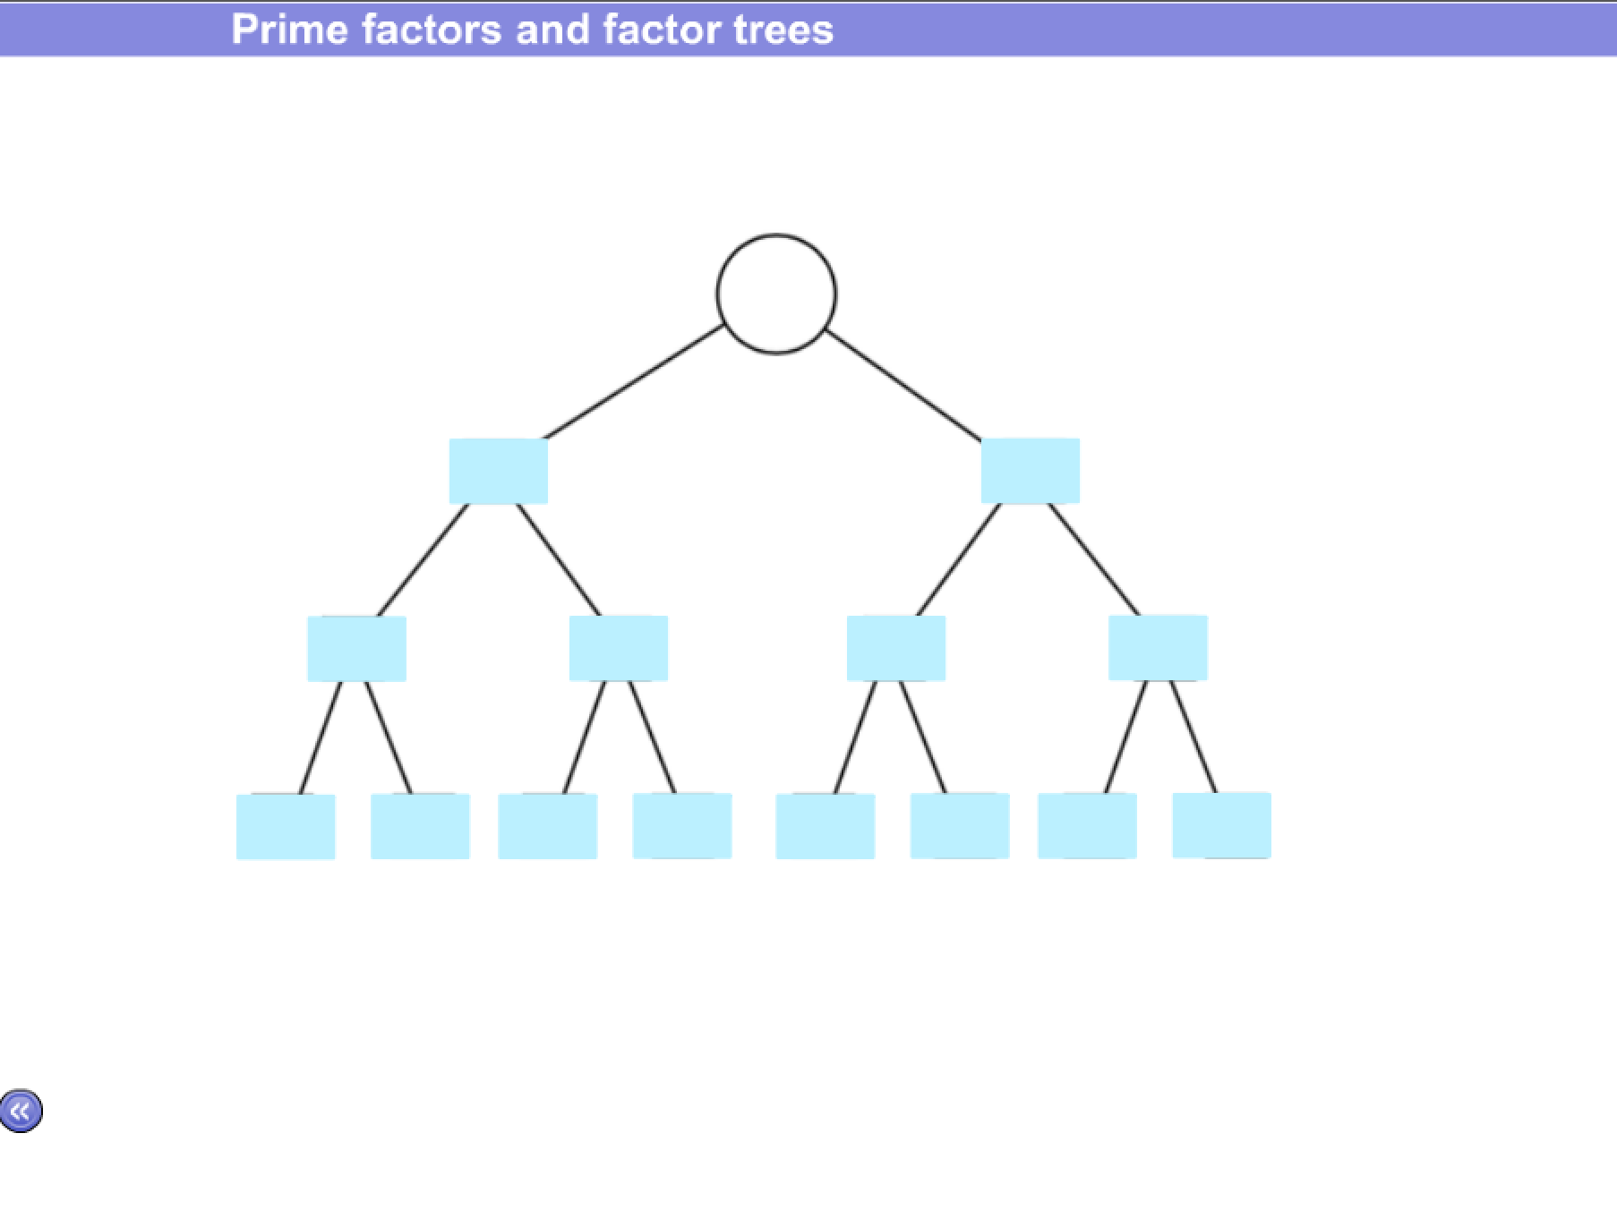
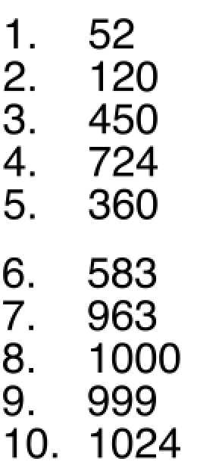
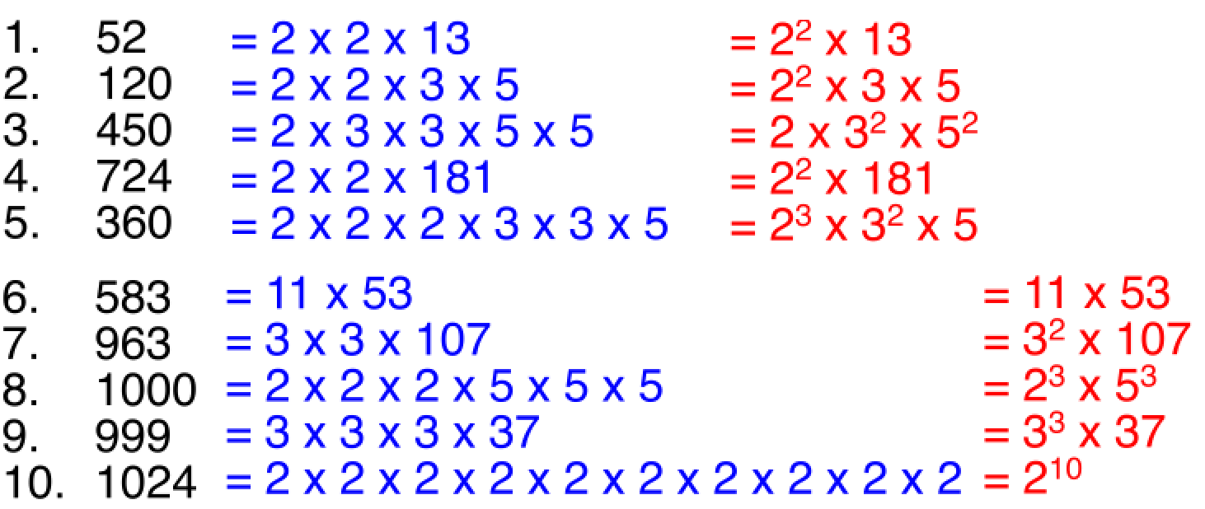

Slide 10
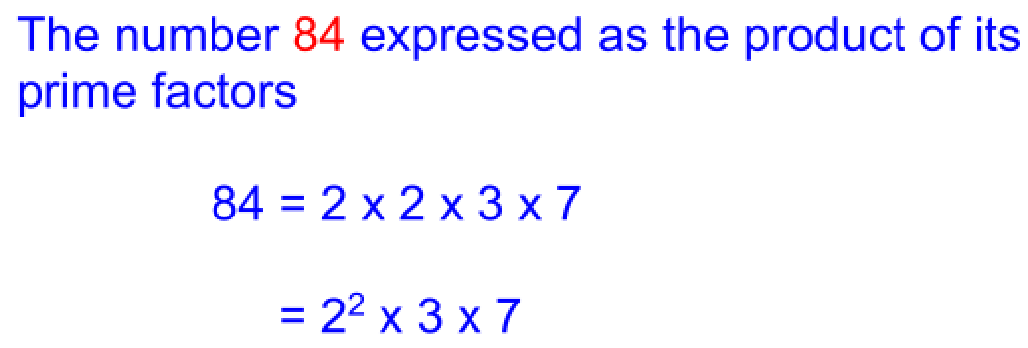
Notes:
Screen 3: Prime factors
A number is shown in a green rectangle. You are asked to find the prime factors of this number. On screen you see the prime numbers 2, 3, 5, 7, 11 and 13 each in a yellow box. You can click the prime numbers. The first time you click any of the prime numbers it appears in an orange rectangle and another rectangle shows the result of the 'green' number divided by the 'orange' number. Clicking another, or the same, prime number, shows the product of the primes clicked so far in the orange rectangle, next to which is shown the 'running' prime factorisation. The result of the 'green' number divided by the 'orange' number is also shown. You can click primes until the quotient of the 'green' number divided by the 'orange' number is 1 or less. If you reach 1 exactly then the number has been correctly factorised and you are told this. At any point before this you can click Clear to go back to the start. The main and review activities "The Vedic square and the shape of numbers" are also about divisibility of numbers.
Key points: being able to find factors easily is important so tests of divisibility may be needed.

Slide 11
Notes:
Screen 3: Prime factors
A number is shown in a green rectangle. You are asked to find the prime factors of this number. On screen you see the prime numbers 2, 3, 5, 7, 11 and 13 each in a yellow box. You can click the prime numbers. The first time you click any of the prime numbers it appears in an orange rectangle and another rectangle shows the result of the 'green' number divided by the 'orange' number. Clicking another, or the same, prime number, shows the product of the primes clicked so far in the orange rectangle, next to which is shown the 'running' prime factorisation. The result of the 'green' number divided by the 'orange' number is also shown. You can click primes until the quotient of the 'green' number divided by the 'orange' number is 1 or less. If you reach 1 exactly then the number has been correctly factorised and you are told this. At any point before this you can click Clear to go back to the start. The main and review activities "The Vedic square and the shape of numbers" are also about divisibility of numbers.
Key points: being able to find factors easily is important so tests of divisibility may be needed.

Slide 12
Notes:
Screen 4: Prime factors and the highest common factor
You are given a red and a blue number and a red and a blue circle that intersect inside a rectangle (in effect a Venn diagram). The prime factors of the red and blue numbers are given beneath the Venn diagram. They are deliberately arranged so that the prime factors of the red number are on the left and of the blue number on the right, but this should not be mentioned. This is a very similar activity to screen 1. You are asked "What is the highest common factor of the two numbers?" but none of this is checked - this is left to you.
Key points: it may not be immediately obvious that some of the prime factors of both should be placed inside the intersection, so leave this for your pupils to work out; likewise it may not be apparent that the highest common factor is the product of the numbers in the intersection; you may also want your pupils to describe the numbers in each section of the rectangle and for some it may be appropriate to work with set notation.

Slide 13
Notes:
Screen 4: Prime factors and the highest common factor
You are given a red and a blue number and a red and a blue circle that intersect inside a rectangle (in effect a Venn diagram). The prime factors of the red and blue numbers are given beneath the Venn diagram. They are deliberately arranged so that the prime factors of the red number are on the left and of the blue number on the right, but this should not be mentioned. This is a very similar activity to screen 1. You are asked "What is the highest common factor of the two numbers?" but none of this is checked - this is left to you.
Key points: it may not be immediately obvious that some of the prime factors of both should be placed inside the intersection, so leave this for your pupils to work out; likewise it may not be apparent that the highest common factor is the product of the numbers in the intersection; you may also want your pupils to describe the numbers in each section of the rectangle and for some it may be appropriate to work with set notation.

Slide 14
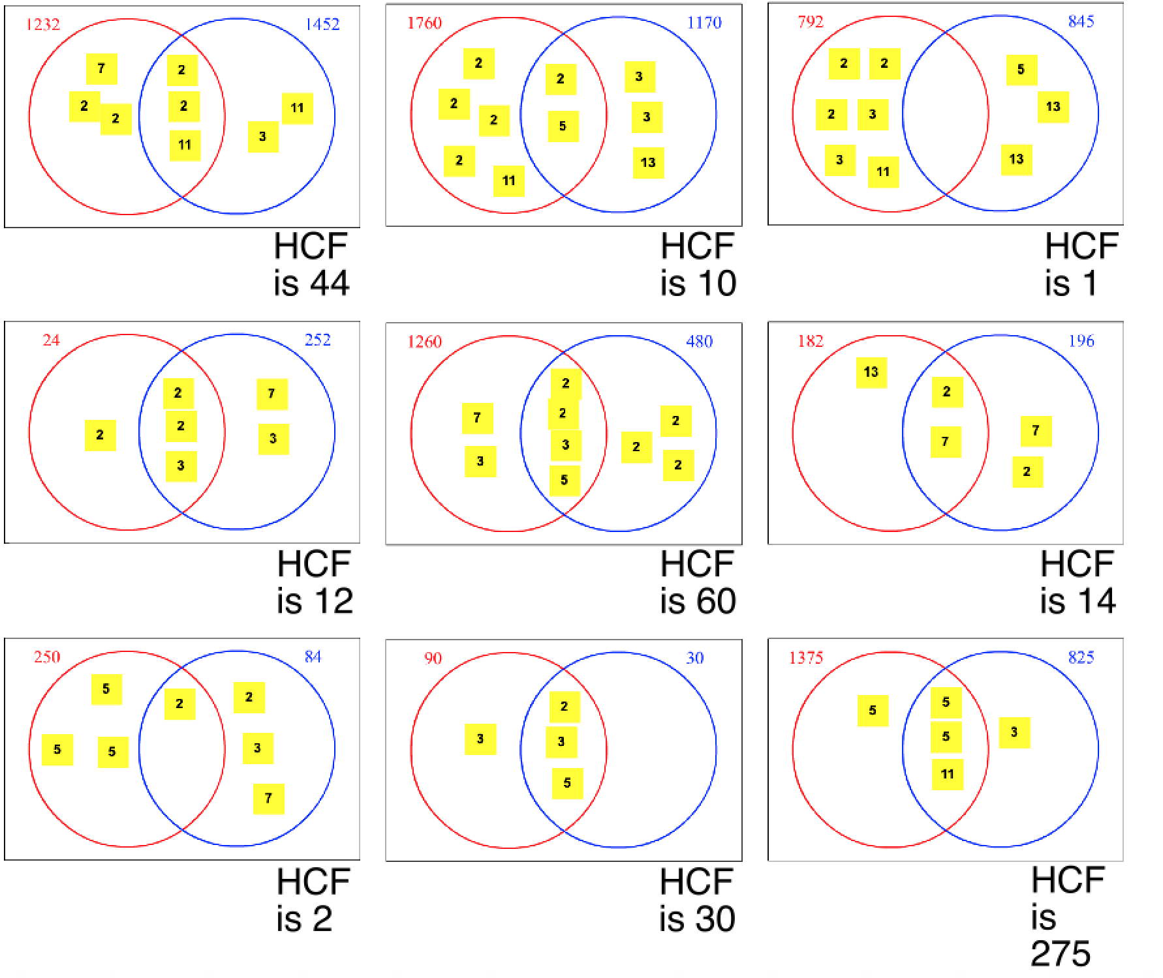
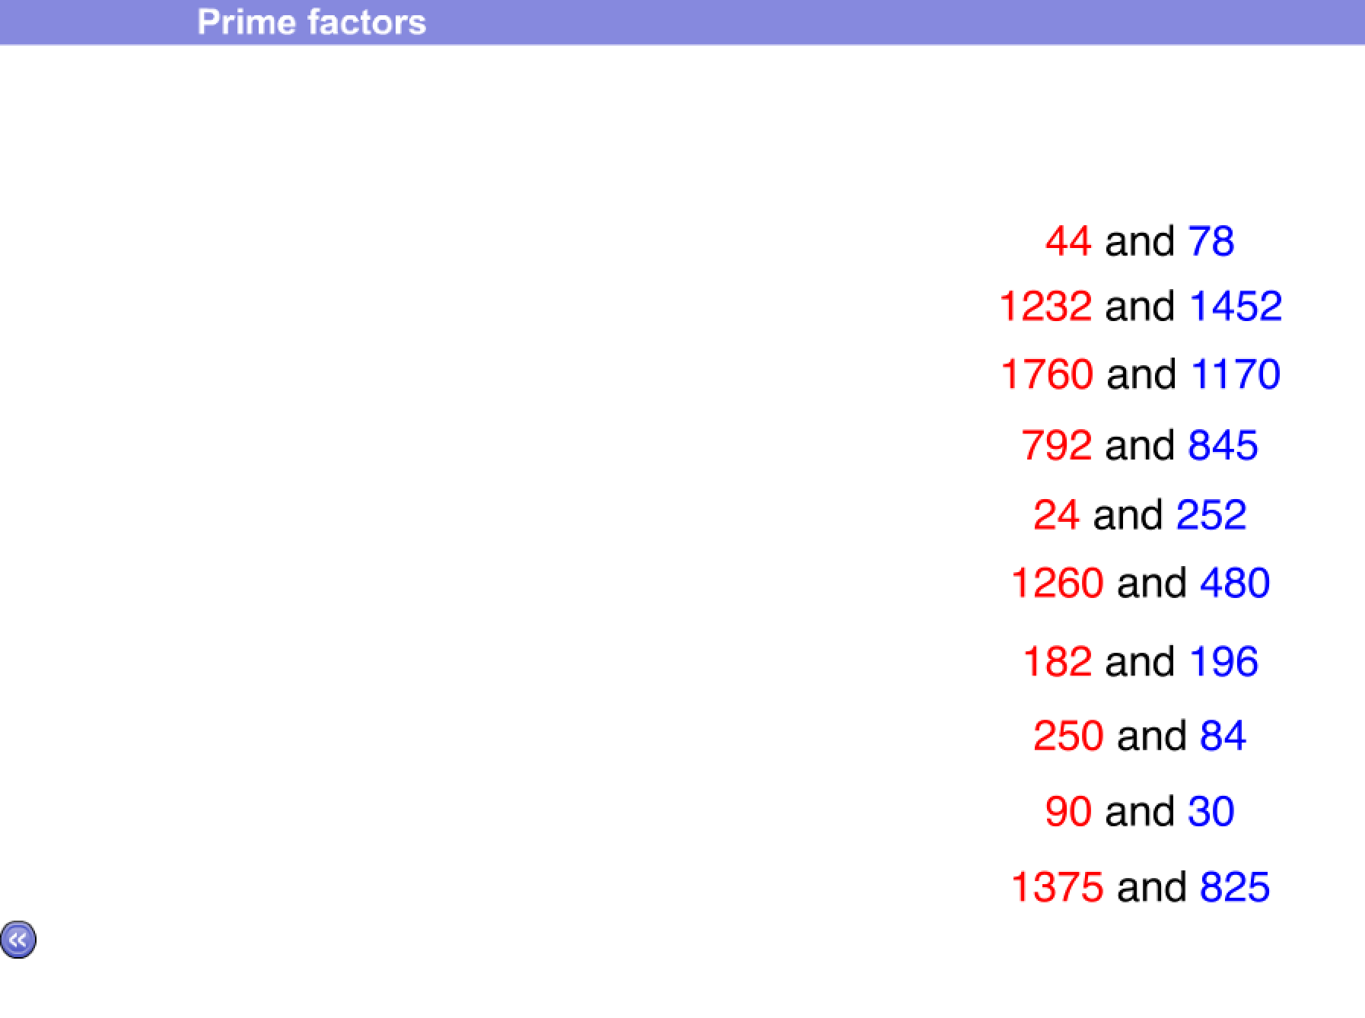
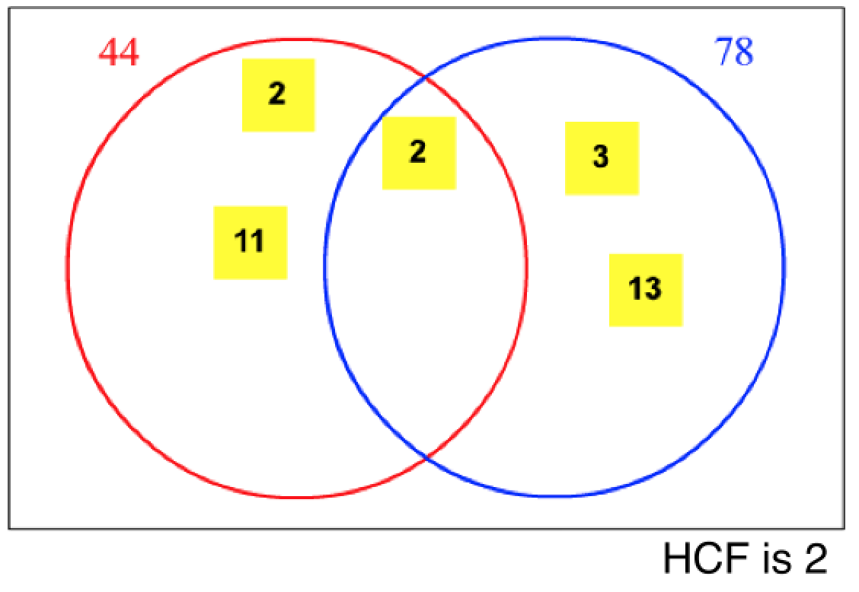

Slide 15
Notes:
Screen 1: The highest common factor
You are given a red and a blue number and a red and a blue circle that intersect inside a rectangle (in effect a Venn diagram). You click Next to be shown all the factors of the two numbers. You click Next and the factors of the red number change colour; click Next again to see just the factors of the blue number change colour; and Next again to see the numbers that are common factors. These common factors are then 'moved' into the intersection of the circles and then the rest of the factors of the two numbers are put into the appropriate places in the diagram.
Key points: it may not be obvious that factors of both should be placed inside the intersection, so it helps to let your pupils clarify this before they see it happen; likewise it may not be apparent that the highest common factor is in the intersection; you may also want your pupils to describe the numbers in each section of the rectangle and for some it may be appropriate to work with set notation.

Slide 16
Notes:
Screen 2: Prime factors
You are shown a number as a product of its prime factors where the prime factors are in some random order. You can click Next to see the product written in a "better way". This arrangement is in numerical order and collects the powers together; for example, 180 is shown as 2² x 3² x 5.
Key points: pupils should discuss why any one way might be a 'better way' and here it is just a convention rather than, for example, a definition (like standard form); pupils could be encouraged to note that the way shown minimises the writing required using the convention of powers.

Slide 17
Notes:
Screen 3: Prime factors and the highest common factor
You are given a red and a blue number and a red and a blue circle that intersect inside a rectangle (in effect a Venn diagram). You click Next to be shown all the prime factors of the two numbers (so that they can be placed in the diagram). You click Next and the prime factors of the red number change colour; click Next again to see just the prime factors of the blue number change colour; and Next again to see the numbers that are common prime factors. These common prime factors are then 'moved' into the intersection of the circles and then the rest of the prime factors of the two numbers are put into the appropriate places in the diagram. Click Next again to see the highest common factor and you are asked to explain why it is the product of the prime factors in the intersection. Finally you are asked "What is the product of the numbers in the red or blue circle?" but you are not given the answer.
Key points: encourage pupils to explain why the prime factors of both should be placed inside the intersection, and also why the other numbers should be not be placed in the intersection; likewise it may not be apparent that the highest common factor is the product of the numbers in the intersection; pupils may not be aware that the product of the numbers in the red circle is the red number; you may also want your pupils to describe the numbers in each section of the rectangle and for some it may be appropriate to work with set notation.

Slide 18
Notes:
Screen 3: Prime factors and the highest common factor
You are given a red and a blue number and a red and a blue circle that intersect inside a rectangle (in effect a Venn diagram). You click Next to be shown all the prime factors of the two numbers (so that they can be placed in the diagram). You click Next and the prime factors of the red number change colour; click Next again to see just the prime factors of the blue number change colour; and Next again to see the numbers that are common prime factors. These common prime factors are then 'moved' into the intersection of the circles and then the rest of the prime factors of the two numbers are put into the appropriate places in the diagram. Click Next again to see the highest common factor and you are asked to explain why it is the product of the prime factors in the intersection. Finally you are asked "What is the product of the numbers in the red or blue circle?" but you are not given the answer.
Key points: encourage pupils to explain why the prime factors of both should be placed inside the intersection, and also why the other numbers should be not be placed in the intersection; likewise it may not be apparent that the highest common factor is the product of the numbers in the intersection; pupils may not be aware that the product of the numbers in the red circle is the red number; you may also want your pupils to describe the numbers in each section of the rectangle and for some it may be appropriate to work with set notation.

Slide 19
Factors and prime factors: Resource Sheet

Slide 20
Prime Factorisation Resource Sheet

