Slide 1
Functions
SPIRE MATHS
Stimulating, Practical, Interesting, Relevant, Enjoyable Maths For All
https://spiremaths.co.uk/functions/

Slide 2
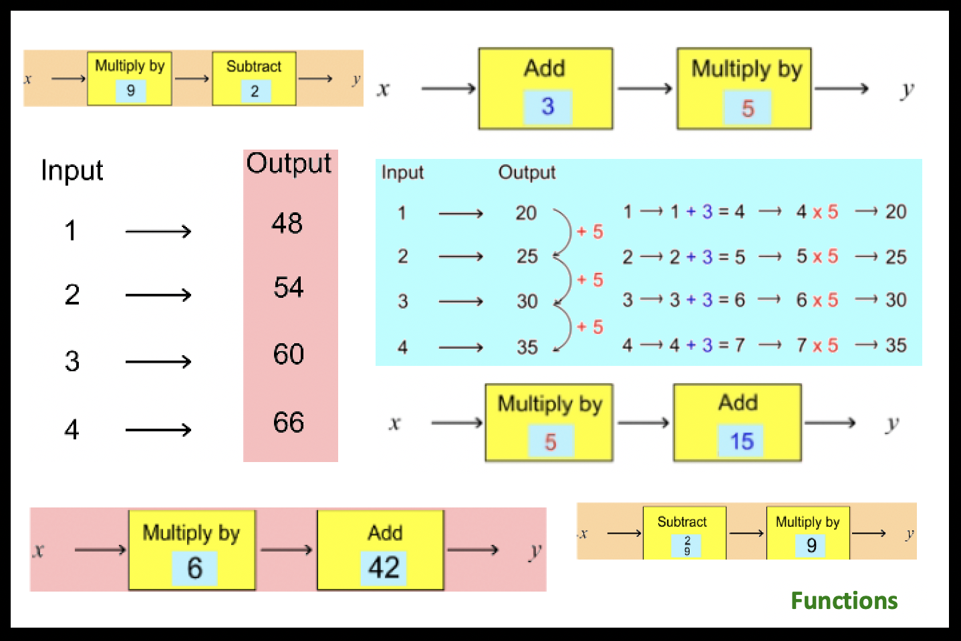
Functions
OBJECTIVE(S): | Input – Output tables for two operations to understand how they determine the regular increment and the initial sero value (as a precursor to gradient-intercept work of straight lines..
DESCRIPTION and OVERVIEW: | Evaluate 4 inputs (not in order) for x5 then -4. What do you notice? Animated work through of answer. Repeat for inputs 1 to 4 for x8 then -7. Answers shown. Ask what do you notice (outputs differ by 8 and they are 8 times table less 1). Five questions for inputs 1 to 4. Solutions shown. Find the two operations (from Add, Subtract and Multiply) for inputs 1 to 4 and outputs 8, 10, 12 and 14. Two answers given: +3, x2; and x2 + 6. Repeat with outputs 1, 8, 15, 22. Two answers: x7 +6; and -6/7 x6. Five given output questions. Each has two answers: first set are multiply then add/subtract all integers only; second set are add/subtract then multiply; and some are fractions or decimal. Solve inputs 1 to 4, outputs 20, 25, 30 and 35. Two animations show x5 +15 and then +3 x5. Question to establish that 5x + 15 = 5(x + 3). Review to show that this is always case, but sometimes fractions make it harder to see the second solution. Note also that in these cases, with inputs separated by 1, the increase gives the multiply value and input 0 gives the add/subtract value (the gradient ahnd the intercept).
EQUIPMENT: | Photocopiable master containing a template for pupils to work with input and output values and 'two operation machines'.
Download ActivInspire, PowerPoint and Teacher Notes from:
https://spiremaths.co.uk/functions/
Two approaches offered: More open (next slide) and a standard guided approach
Go to Standard method
Notes:
Input – Output tables for two operations to understand how they determine the regular increment and the initial sero value (as a precursor to gradient-intercept work of straight lines..
Evaluate 4 inputs (not in order) for x5 then -4. What do you notice? Animated work through of answer.
Repeat for inputs 1 to 4 for x8 then -7. Answers shown. Ask what do you notice (outputs differ by 8 and they are 8 times table less 1).
Five questions for inputs 1 to 4. Solutions shown.
Find the two operations (from Add, Subtract and Multiply) for inputs 1 to 4 and outputs 8, 10, 12 and 14. Two answers given: +3, x2; and x2 + 6.
Repeat with outputs 1, 8, 15, 22. Two answers: x7 +6; and -6/7 x6.
Five given output questions. Each has two answers: first set are multiply then add/subtract all integers only; second set are add/subtract then multiply; and some are fractions or decimal.
Solve inputs 1 to 4, outputs 20, 25, 30 and 35. Two animations show x5 +15 and then +3 x5. Question to establish that 5x + 15 = 5(x + 3).
Review to show that this is always case, but sometimes fractions make it harder to see the second solution.
Note also that in these cases, with inputs separated by 1, the increase gives the multiply value and input 0 gives the add/subtract value (the gradient ahnd the intercept).
Photocopiable master containing a template for pupils to work with input and output values and 'two operation machines’.
Enjoy
Davem195@ntlworld.com

Slide 3
Both these double machines produce the same output
1. Is this always possible for any similar regular input-outputs as shown? 2. What else can you find out?
Go to Animation Page
Go to Review Page
A More Open Approach
Go to Standard method
Notes:
More open-ended approach. Any of other slides could complement – otherwise allows jump to slides 11 (Animations) or 12 (the review page)

Slide 4
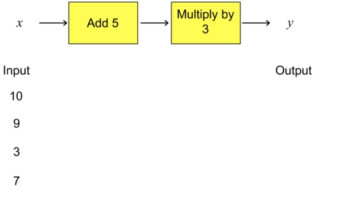
Evaluate:
What do you notice about the outputs?
Function Machines 1
Notes:
Evaluate 4 inputs (not in order) for x5 then -4. What do you notice? Animated work through of answer.
Inputs are deliberately randomly ordered in this and next slide. Function machines here made up of two parts one of form Add/Subtract number the other Multiply by number (could ask – how would we include divide ‘without changing anything’. Outputs can be seen that they are all multiples of 3.

Slide 5
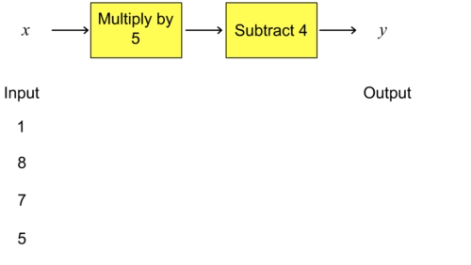
Evaluate:
What do you notice about the outputs?
Function Machines 1.1
Notes:
Repeat for inputs 1 to 4 for x8 then -7. Answers shown. Ask what do you notice (outputs differ by 8 and they are 8 times table less 1).

Slide 6
Evaluate:
What do you notice about the outputs?
Function Machines 2
Notes:
Five questions for inputs 1 to 4. Solutions shown.
Outputs go up by 8. They are one less than the multiples of 8 (8 times table take away 1). Easy to see now in order. For later the 8 gives the gradient of corresponding line and the -1 (subtract 1) the intercept (i.e. when input = 0).

Slide 7
Evaluate:
Function Machines 2.1
What do you notice about the outputs?
Notes:
Outputs go up by 8. They are one less than the multiples of 8 (8 times table take away 1). Easy to see now in order. For later the 8 gives the gradient of corresponding line and the -1 (subtract 1) the intercept (i.e. when input = 0).

Slide 8
What operation goes into the yellow box, what number in the blue rectangle?
Finding Functions 1
Notes:
Find the two operations (from Add, Subtract and Multiply) for inputs 1 to 4 and outputs 8, 10, 12 and 14. Two answers given: +3, x2; and x2 + 6.

Slide 9
What operation goes into the yellow box, what number in the blue rectangle?
Finding Functions 2
Notes:
Repeat with outputs 1, 8, 15, 22. Two answers: x7 +6; and -6/7 x6. You may decide not to focus particularly on fraction answers.
Five given output questions. Each has two answers: first set are multiply then add/subtract all integers only; second set are add/subtract then multiply; and some are fractions or decimal.

Slide 10
Solve these in at least one way. Do you think there is always a second solution?
Finding Functions 3
Notes:
Five given output questions. Each has two answers: first set are multiply then add/subtract all integers only; second set are add/subtract then multiply; and some are fractions or decimal.

Slide 11
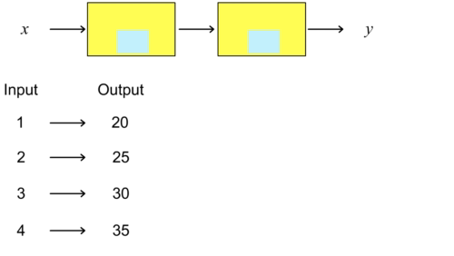
Work out the two solutions then watch.
When is it easier to find 2 solutions?
Finding Functions: Two Animations
Notes:
Solve inputs 1 to 4, outputs 20, 25, 30 and 35. Two animations show x5 +15 and then +3 x5. Question to establish that 5x + 15 = 5(x + 3).

Slide 12
1. What have you learned about how the inputs and outputs match? 2. What are the key points for your learning?
Multiply number = difference between consecutive inputs (when going up in ones)
Gradient = 8 Intercept = -1
Add or Subtract number = what happens if input is 0
Whole result of a Multiply first then Add or Subtract is like times tables values moved up or down by Add or Subtract value
Add or Subtract then Multiply will also give solution, but Add or Subtract number might be a fraction
Review
Notes:
Review to show that this is always case, but sometimes fractions make it harder to see the second solution.
Note also that in these cases, with inputs separated by 1, the increase gives the multiply value and input 0 gives the add/subtract value (the gradient ahnd the intercept).

Slide 13
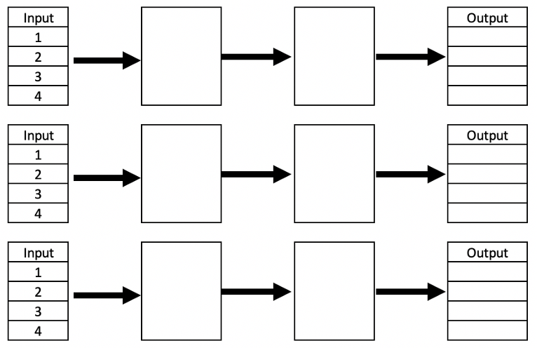
Printer version next page
Functions Resource Sheet
Notes:
Photocopiable master (printable next page) containing a template for pupils to work with input and output values and 'two operation machines'.

Slide 14
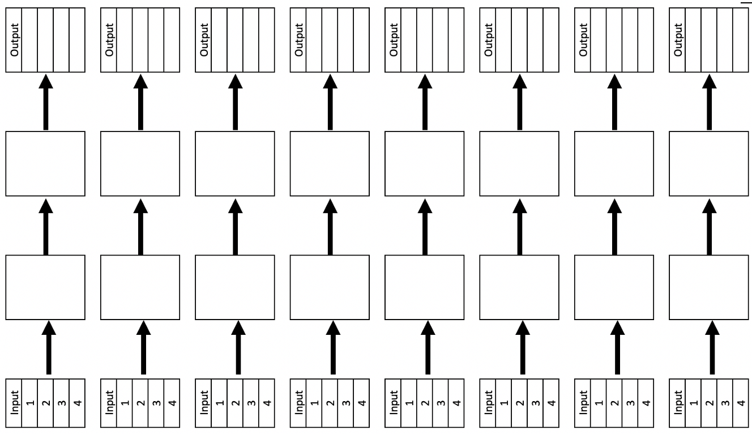
Functions Resource Sheet
Notes:
Photocopiable master containing a template for pupils to work with input and output values and 'two operation machines'.

