Slide 1
Populations and the Census 2021
SPIRE MATHS
Stimulating, Practical, Interesting, Relevant, Enjoyable Maths For All
https://spiremaths.co.uk/populations/

Slide 2
Answers, PowerPoint, ActivInspire file and Teacher notes with three worksheets are available for this resource.
https://spiremaths.co.uk/populations/
Populations

Slide 3
From the Guardian 29 October 2014.
Previous general election refers to 2010.
Answers follow each pair of questions.
Keep your own score.
How well do you know the UK (2014)?

Slide 4
The population of the United Kingdom on Census Day 2001 (Sunday April 29) was 58,789,194.
Predict the order of the countries in the UK by population, highest first
The populations of the individual countries were (in size order of population):
Predict the population in millions before you see it
England
49,138,831 = 83.6%
Scotland
5,062,011 = 8.6%
Wales
2,903,085 = 4.9%
Northern Ireland
1,685,267 = 2.9%
Census Day 2001

Slide 5
The population of England and Wales on Census Day 2001 (Sunday April 29) was 52,041,916.
The populations of the individual countries were (in size order of population):
England
49,138,831 = 94.4%
Wales
2,903,085 = 5.6%
Census Day 2011

Slide 6
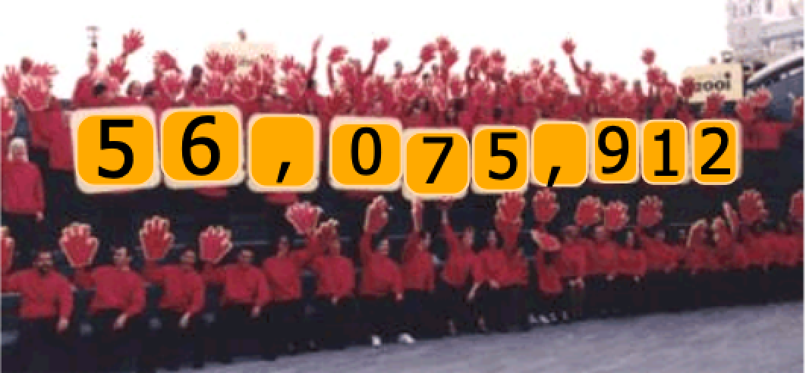
The population of England and Wales on Census Day 2011 (Sunday March 27) was 56,075,912.
The populations of the individual countries were (in size order of population):
England
53,013,300 = 94.2%
Wales
3,063,500 = 5.8 %
Census Day 2011

Slide 7
The population of England and Wales on Census Day 2011 was 56,075,912 and on Census Day 2001 was 52,041,916.
The populations England and Wales was in:
2011
56,075,912
2001
52,041,916
Increase
4,033,996
Percentage Increase
Just under 8% increase
Census Day 2011 and 2001

Slide 8
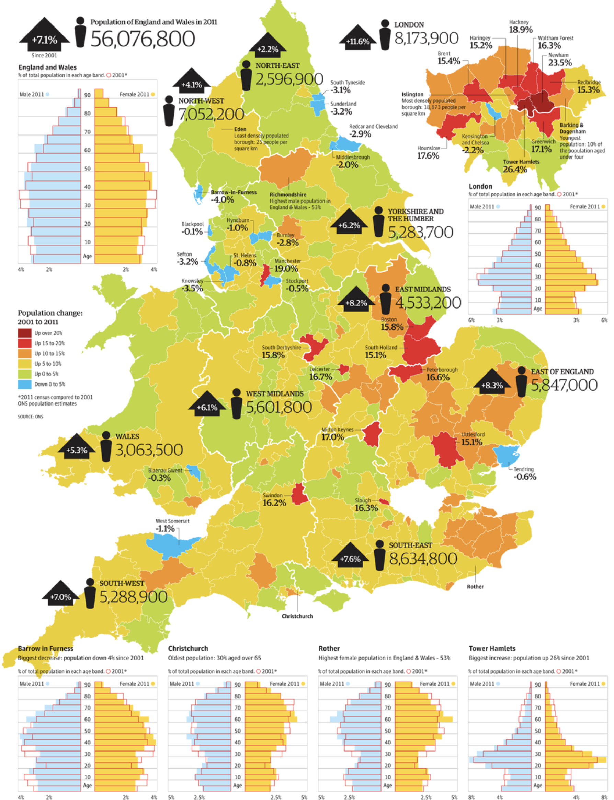
Click for Guardian Poster
According to the Guardian
Census Day 2011

Slide 9
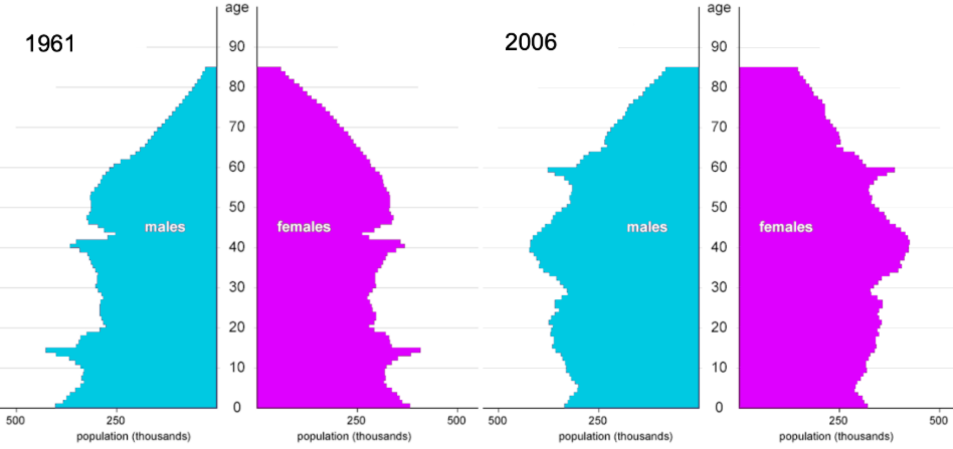
Worksheet available in teacher notes
What do you see?
What do you think?
Population Pyramids for 1991 and 2006

Slide 10
What do the black lines show?
The two population pyramids show the number of males/females alive in each age group in 1961 and 2006.
Population Pyramids for 1991 and 2006

Slide 11
The United Nations defines four essential features of a modern population census.
It must involve
individual enumeration,
it must be universal within the defined territory,
it must be simultaneous and
it must happen at regular intervals.
There have been numerous attempts at tallying the British population, going back to the Domesday Book of 1086.
The censuses of 1801-1831 lacked two of the four defining features of a modern census: they were not completed simultaneously and individuals were not counted separately.
Census History: The Sunday Times
From Sunday Times of 14 March 2021

Slide 12
There has been a census (as defined by the UN) in the UK every 10 years from 1841, except during the Second World War in 1941.
The individual results for 1931 were destroyed in a fire and other individual results cannot be revealed until 100 years have passed.
In 1939 a register of where people lived was taken at the start of WW2.
Results for 1841 to 1911 can be searched to help with family histories, but you may have to pay to find detailed results.
The results for 1921 will be available in 2022.
'Large data' results are available for all years.
Census 1911-2011 overview

Slide 13
Worksheet available in teacher notes
Here are the population pyramids from 1911 to 2011 (except 1941). They are not in the correct order as you read across then down. All are to the same scale.
Use logic to put them in order.
Go to Answer
Population Pyramids 1911 - 2011

Slide 14
Census 1911-2011: 1911
Go to 1911 census
Go to 1921 census
Go to 1931 census
Go to 1951 census
Go to 1961 census
Go to 1971 census
Go to 1981 census
Go to 1991 census
Go to 2001 census
Go to 2011 census
Click a link on the right to see the combined population of England and Wales, the population pyramid and a description of its shape and information about the times for the given year.
Go to 2021 census

Slide 15
Census 1911-2011: 1921
Go to 1911 census
Go to 1921 census
Go to 1931 census
Go to 1951 census
Go to 1961 census
Go to 1971 census
Go to 1981 census
Go to 1991 census
Go to 2001 census
Go to 2011 census
Click a link on the right to see the combined population of England and Wales, the population pyramid and a description of its shape and information about the times for the given year.
Go to 2021 census

Slide 16
Census 1911-2011: 1931
Go to 1911 census
Go to 1921 census
Go to 1931 census
Go to 1951 census
Go to 1961 census
Go to 1971 census
Go to 1981 census
Go to 1991 census
Go to 2001 census
Go to 2011 census
Click a link on the right to see the combined population of England and Wales, the population pyramid and a description of its shape and information about the times for the given year.
Go to 2021 census

Slide 17
Census 1911-2011: 1951
Go to 1911 census
Go to 1921 census
Go to 1931 census
Go to 1951 census
Go to 1961 census
Go to 1971 census
Go to 1981 census
Go to 1991 census
Go to 2001 census
Go to 2011 census
Click a link on the right to see the combined population of England and Wales, the population pyramid and a description of its shape and information about the times for the given year.
Go to 2021 census

Slide 18
Census 1911-2011: 1961
Go to 1911 census
Go to 1921 census
Go to 1931 census
Go to 1951 census
Go to 1961 census
Go to 1971 census
Go to 1981 census
Go to 1991 census
Go to 2001 census
Go to 2011 census
Click a link on the right to see the combined population of England and Wales, the population pyramid and a description of its shape and information about the times for the given year.
Go to 2021 census

Slide 19
Census 1911-2011: 1971
Go to 1911 census
Go to 1921 census
Go to 1931 census
Go to 1951 census
Go to 1961 census
Go to 1971 census
Go to 1981 census
Go to 1991 census
Go to 2001 census
Go to 2011 census
Click a link on the right to see the combined population of England and Wales, the population pyramid and a description of its shape and information about the times for the given year.
Go to 2021 census

Slide 20
Census 1911-2011: 1981
Go to 1911 census
Go to 1921 census
Go to 1931 census
Go to 1951 census
Go to 1961 census
Go to 1971 census
Go to 1981 census
Go to 1991 census
Go to 2001 census
Go to 2011 census
Click a link on the right to see the combined population of England and Wales, the population pyramid and a description of its shape and information about the times for the given year.
Go to 2021 census

Slide 21
Census 1911-2011: 1991
Go to 1911 census
Go to 1921 census
Go to 1931 census
Go to 1951 census
Go to 1961 census
Go to 1971 census
Go to 1981 census
Go to 1991 census
Go to 2001 census
Go to 2011 census
Click a link on the right to see the combined population of England and Wales, the population pyramid and a description of its shape and information about the times for the given year.
Go to 2021 census

Slide 22
Census 1911-2011: 2001
Go to 1911 census
Go to 1921 census
Go to 1931 census
Go to 1951 census
Go to 1961 census
Go to 1971 census
Go to 1981 census
Go to 1991 census
Go to 2001 census
Go to 2011 census
Click a link on the right to see the combined population of England and Wales, the population pyramid and a description of its shape and information about the times for the given year.
Go to 2021 census

Slide 23
Census 1911-2011: 2011
Go to 1911 census
Go to 1921 census
Go to 1931 census
Go to 1951 census
Go to 1961 census
Go to 1971 census
Go to 1981 census
Go to 1991 census
Go to 2001 census
Go to 2011 census
Click a link on the right to see the combined population of England and Wales, the population pyramid and a description of its shape and information about the times for the given year.
Go to 2021 census

Slide 24
Census Day 2021
Go to 1911 census
Go to 1921 census
Go to 1931 census
Go to 1951 census
Go to 1961 census
Go to 1971 census
Go to 1981 census
Go to 1991 census
Go to 2001 census
Go to 2011 census
Go to 2021 census
https://census.gov.uk

Slide 25
1911 1921 1931 1951 1961
1971 1981 1991 2001 2011
Go back
Here is the correct order.
Population Pyramids 1911 - 2011

